Slide 1

Belgrade Jewish Women’s Societies From the establishment until the WWII
BJWS

Slide 2

In Judaism the equality of men and women begins at the highest possible level: G-d has never been viewed as exclusively male or masculine.
Further “G-d created man in His image, in the image of G-d He created him; male and female He created them.”
(Genesis 1:27)
Therefore man and woman are equal, created in the image of God, and there are no difference between them.

Slide 3
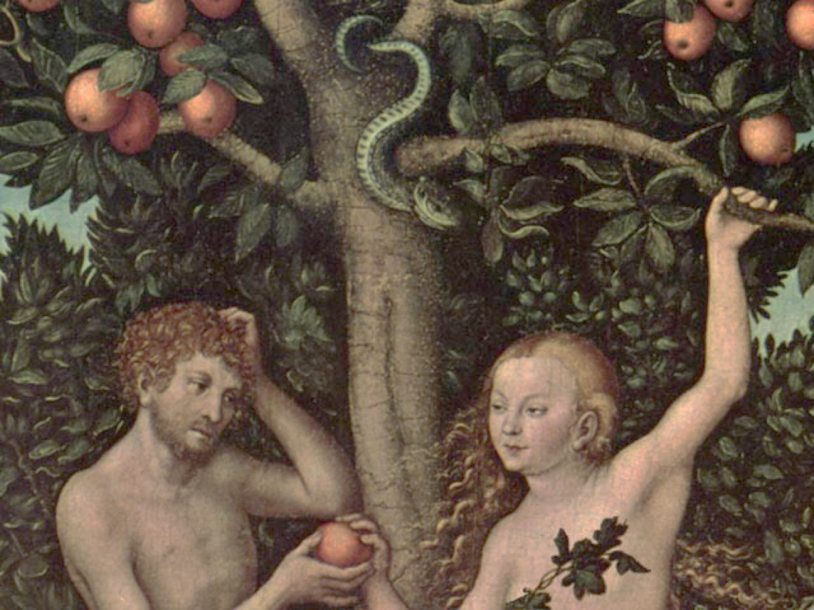
State of equality was disturbed because of the woman’s fault.
A consequence follows – woman desire [shall be] for her husband, and he shall rule over her (Genesis 3:16).
Despite all this, the Jewish woman never had subservient position. She was highly respected by a man. She was active participant in the social, educational, and religious life of the community.

Slide 4

Salome Alexandra (Queen Shlomzion, 141- 67 BCE), the ruler
of Judea, perhaps is a one of the best examples of this claim.
Shimeon ben Shetah, leading Pharisee of the time, reformed the
court system (Sanhedrin) under her patronage.
Salome introduced compulsory education not only for male, but also for female children.
Also, she instituted the ketubah – the woman’s portion of a marriage contact that specified the obligations of the groom toward his bride which still exists today.

Slide 5
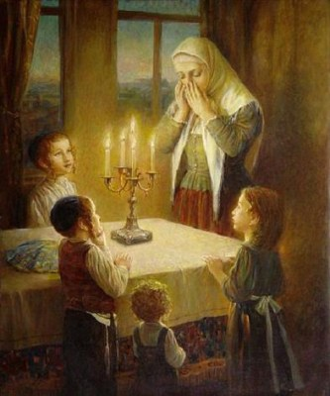
In the Talmudic Period (70 - 500 CE) woman’s position in the society changed, however, not in her favor. She was not allowed to go in public, to attend the schools, to study a Torah.
Since then Jewish woman devoted all her energies to the family well-being. She was a good wife and a gentle loving mother.
However, she has been given the privilege of ushering in the holy Shabbat by lighting the candles on Friday.

Slide 6
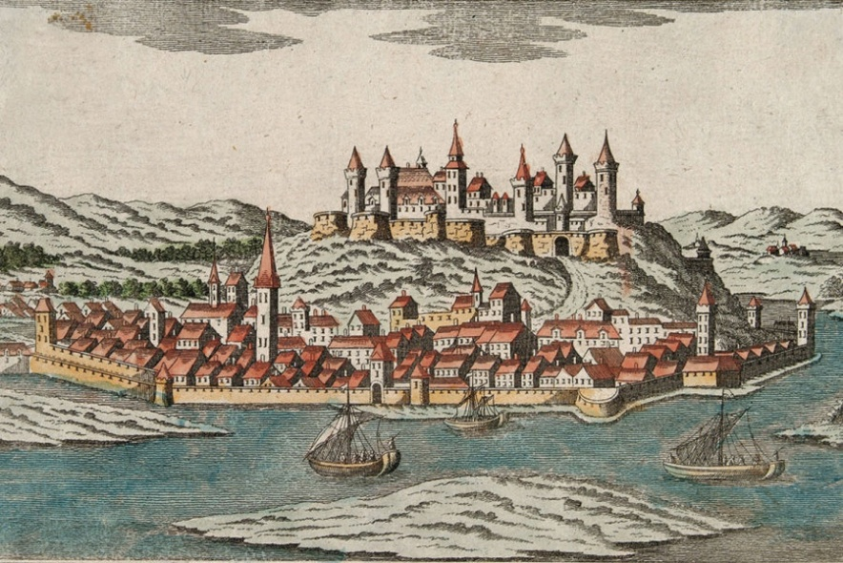
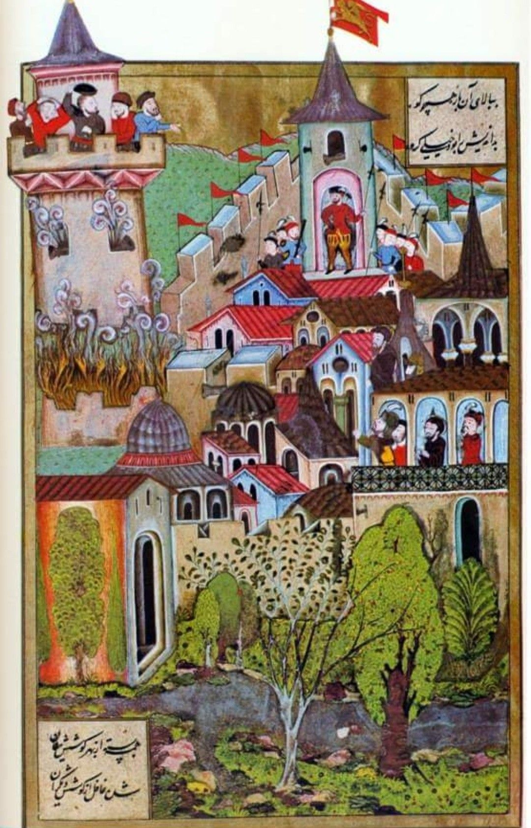
The first written trace about Belgrade Jewish community dates to the 16th century, that was a time of Ottoman rule of the city.
Although there were already the Ashkenazi living population at that time, a sudden influx of Spanish Jews will soon make Belgrade an important Sephardic center.

Slide 7
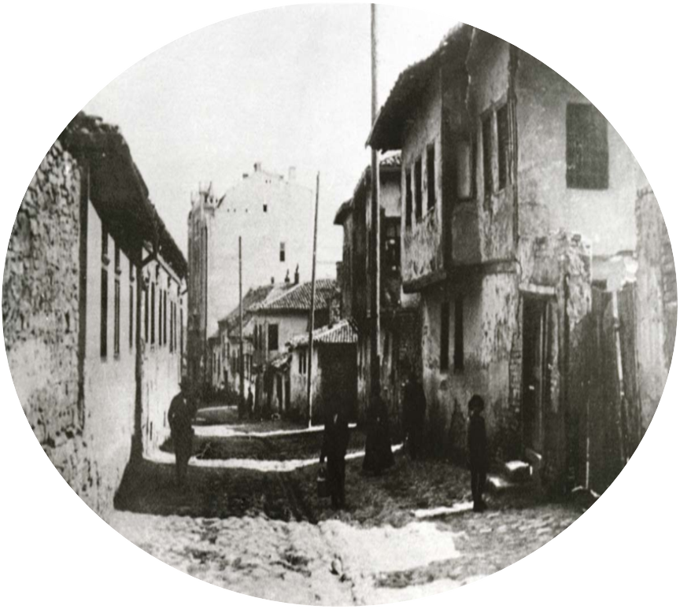
Sephardic Jews inhabited the Belgrade quarter called Jalija (Turkish - bank, shore), spread between the old merchant port on the Danube, and the King Peter and Emperor Dušan Streets, that was the hub of Belgrade’s trade.

Slide 8
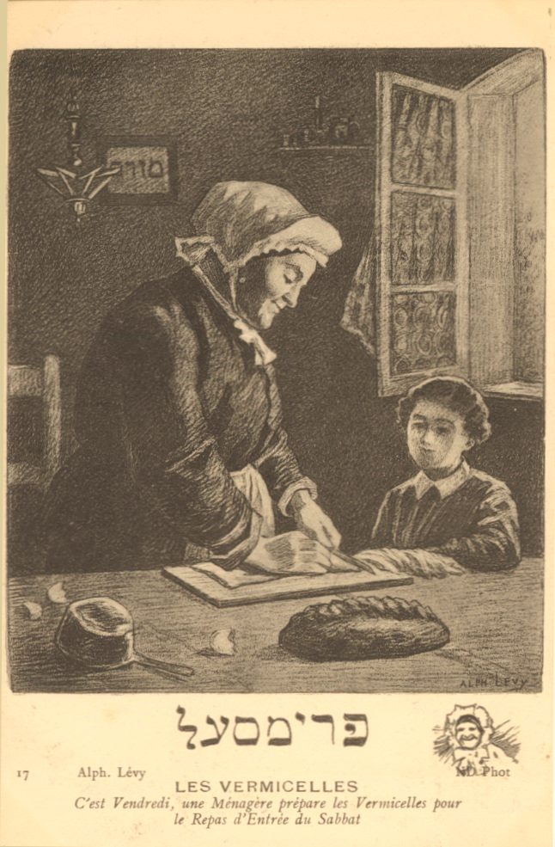
They lived piously, according the every-day's routine.
Men dealt with craft and trade, while women cared about home and family, maintained the customs passed down by their mothers and transmitted their knowledge and strong sense of identity to their children.
Amount of housework made women stay at home most of the time.

Slide 9
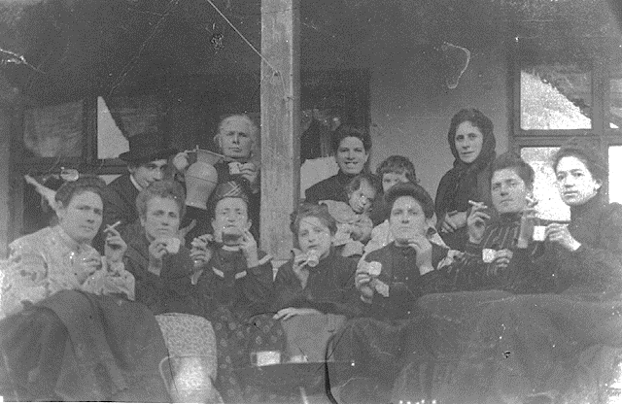
After liberation of Belgrade from Turks in 1862, the life of Jews was significantly modified. They became closer with Serbs and got a Serbian citizenship.
Changes to a Jewish conservative home were subtle, but more visible.

Slide 10
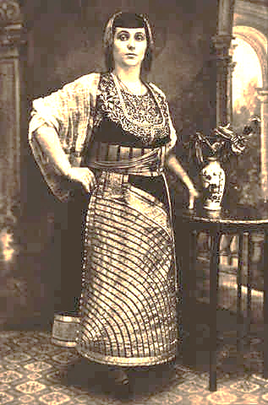
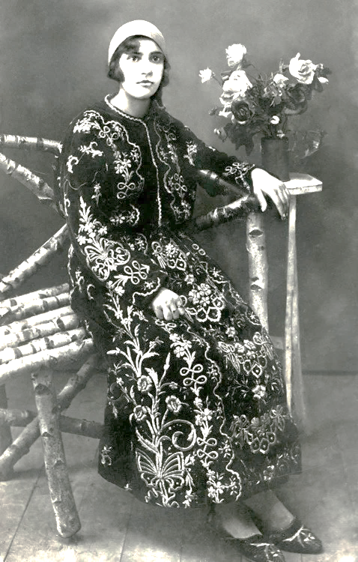
Jewish women was particularly influenced by modern and progressive environment, coming to Serbia from the Western European countries.
The drift towards a less traditional way of life affected young as well as old.
Jewish women rejected Turkish clothing and became more fashionable. Further, they were eager for a knowledge and succeeded in effort to open the Jewish Girls’ School in 1864. Finally, Belgrade Jewish Women organized themselves on a national scale and were pioneers in establishing women organizations in Serbia.

Slide 11
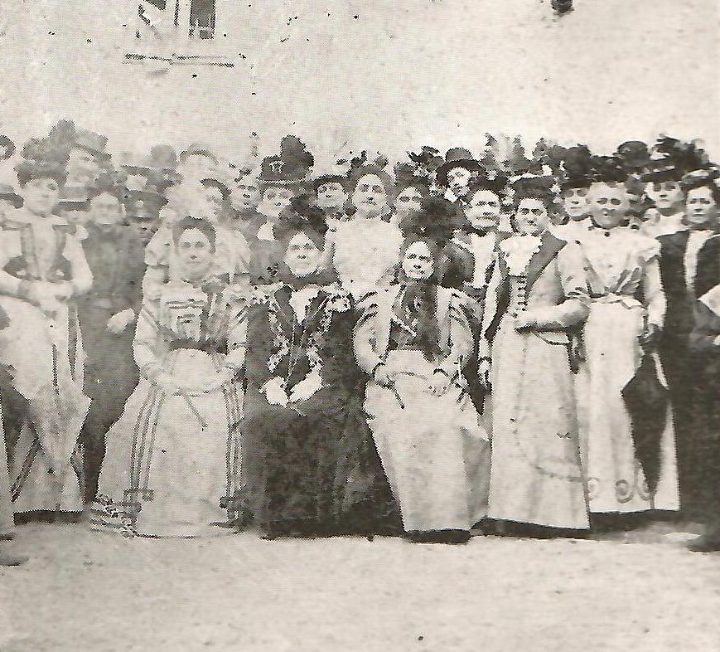
Jewish Women’s Society
(Jevrejsko žensko društvo)
The first women’s organization in Serbia – Jewish Women’s Society –
was founded by three Sephardic ladies in Belgrade in 1874.
Jewish Women’s Society in 1900

Slide 12
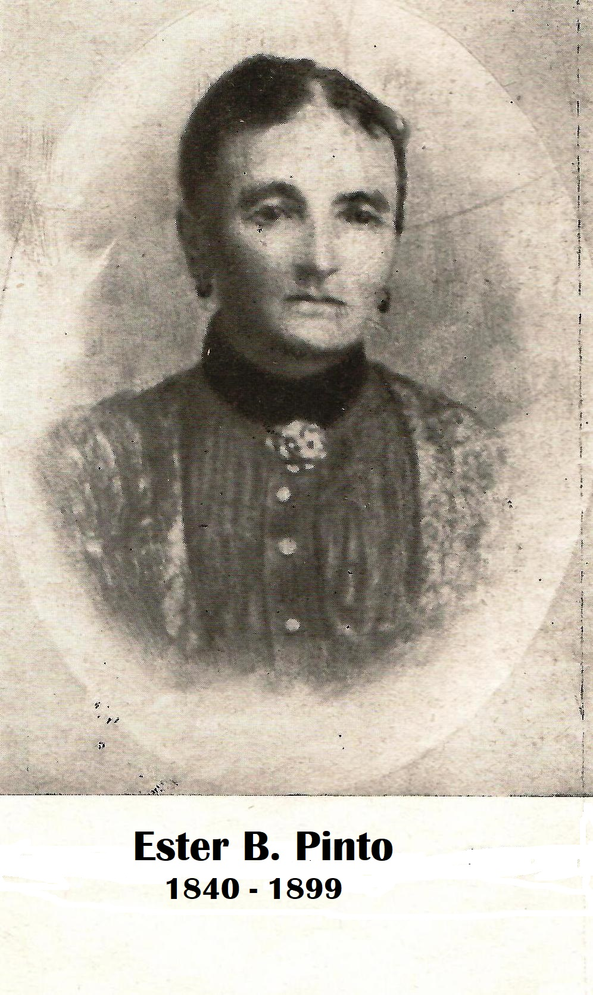
Ester Pinto took the initiative, and proposed to her close friends, Toni Azriel and Sara Alkalaj, to unite with her helping girls to prepare a dowry for marriage.
At the very beginning no less important was a care of women during their maternity period. In the later days, the goal of the Society widened to provide clothing for needy.

Slide 13
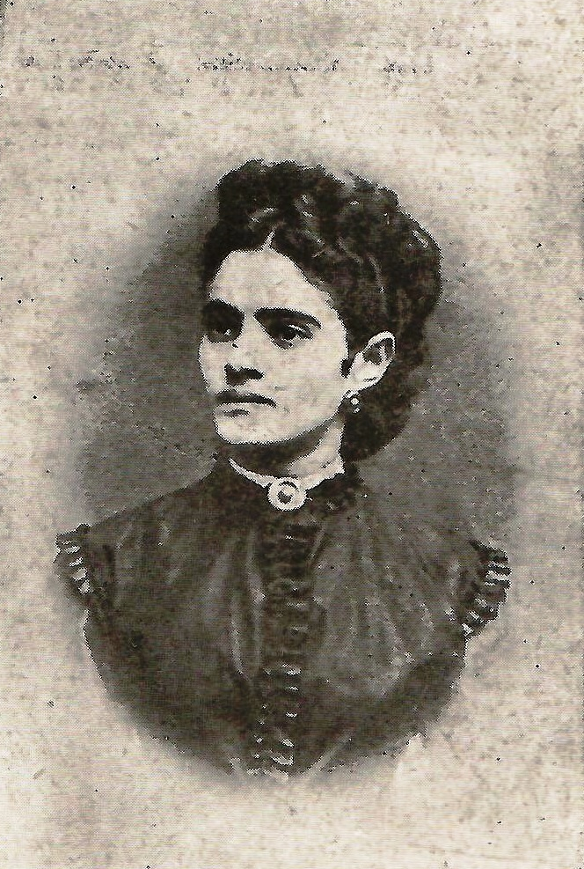
Toni Azriel was the first elected president of the Jewish Women’s Society.
She was Viennese cultured women and highly respected among her Jewish compatriots.
After six years of devoted work in the Society, she and her husband left Belgrade and moved to Austria in 1880. Despite being back in Vienna, Toni stayed in constant touch with her friends helping them manage their Society.
Toni Azriel

Slide 14
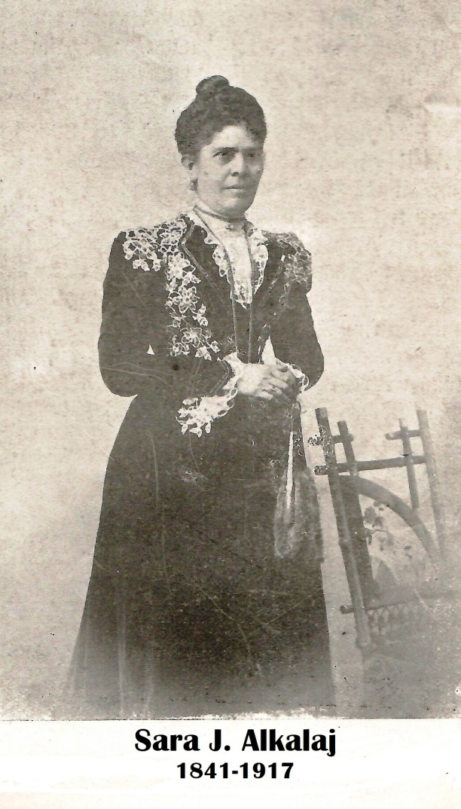
Sara Alkalaj was a treasurer when the Society started operating.
Through the years she got involved in all aspects of Society’s activities.
As a member of the Jewish Women’s Society Board she worked entire 44 years, from 1874 to 1914.

Slide 15
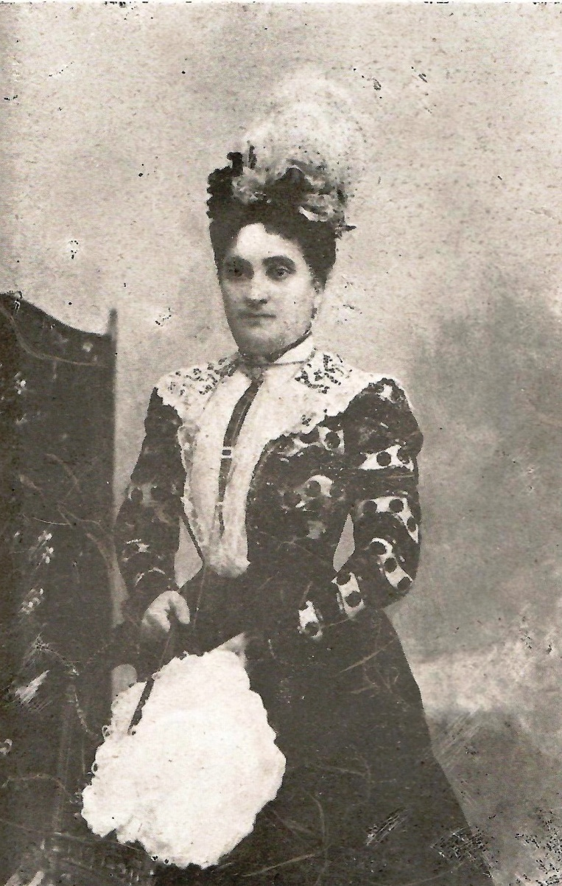
Solči Buli was the second president of the Jewish Women’s Society, from 1880 to 1890. In the next 17 years, from 1890 to 1907, she was a vice president.
Solči was one of the most energetic women of that time.
During her mandate as a president, the Jewish Women’s Society took part in a wide range of activities of Serbian Women.
Solči Buli

Slide 16
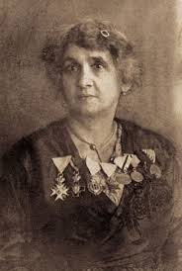
Neti Munk, nee Tajtacak, was a Serbian humanitarian worker, volunteer nurse, and decorated war hero.
As a volunteer nurse, she applied for the first time at the age of 20, during the Serbo-Bulgarian War of 1885, and later participated in all the wars Serbia led for independence, liberation and unification: in the First Balkan War, the Second Balkan War, and World War I.
Neti was a member of the Governing Board of the Jewish Women's Society.
Neti Munk (1864-1924)

Slide 17
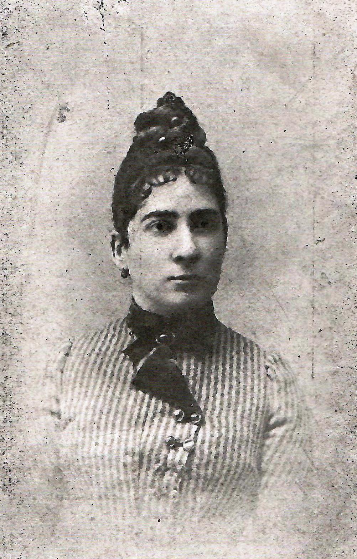
Luča Levi was appointed president in 1890.
Her activities were interrupted too early, she died at the age of 36, in 1894.
Luča was well educated and wrote beautiful poems in Ladino that were unfortunately never published.
Luča Levi

Slide 18
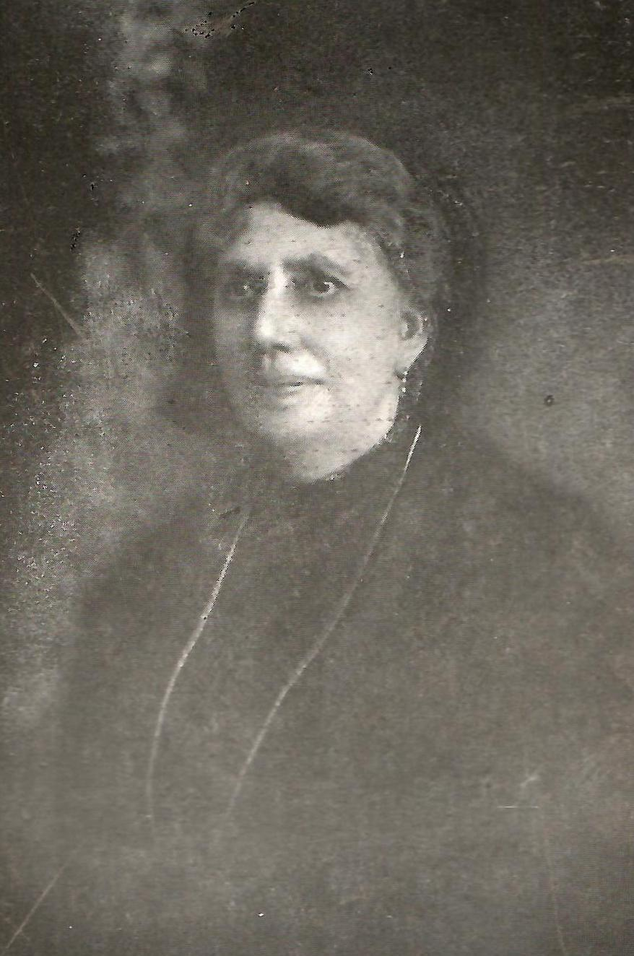
During Merkuša Buli term of appointment, which began in 1894, the members of the Society were well educated women whose participation led organization to more professional level.
Merkuša Buli

Slide 19
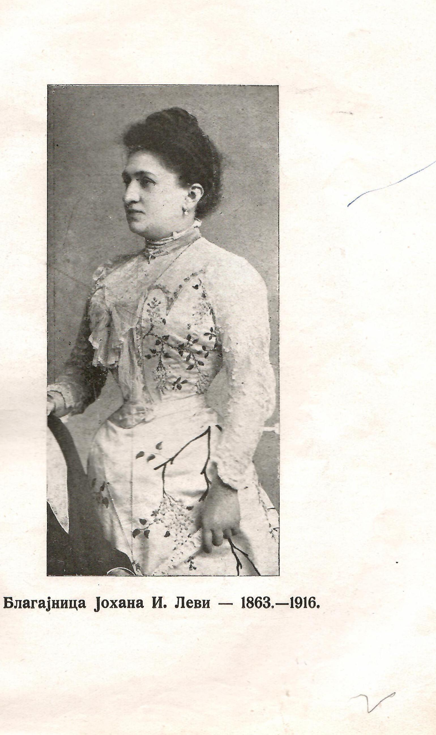
Johana Levi, the treasurer of the Jewish Women’s Society, introduced accounting books for the first time.
On her own initiative the Federation of Serbian Women were established in 1906.
Although the process of integration into Serbian society started to take hold, the spoken language of Belgrade’s Jews was still Ladino and all official documents and correspondence, including the Regulation of the Jewish Women’s Society, were written in Judeo-Spanish.
Johana Levi

Slide 20
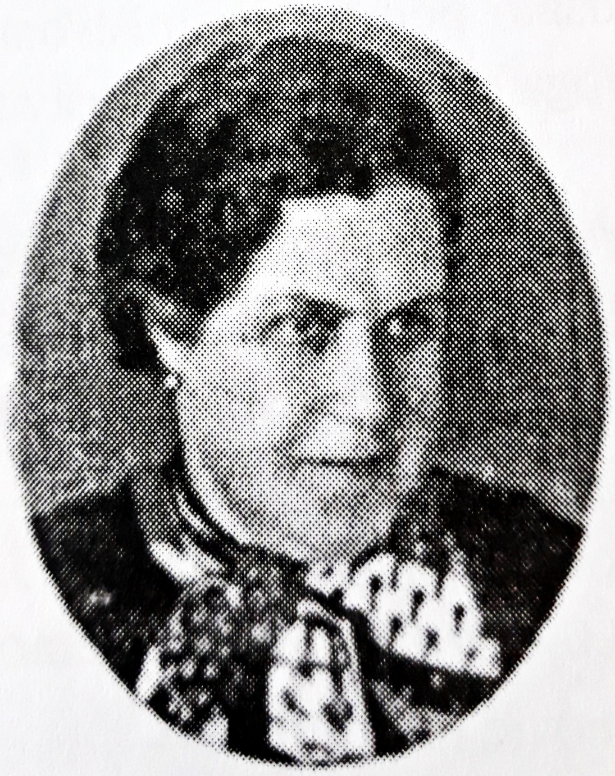
Jelena de Majo was a first secretary of the Jewish Women’s Society, appointed in 1905.
She introduced an important change - the meeting minutes has been kept in Serbian language.
In 1922 Jelena became the president of the Jewish Women’s Society.
Jelena de Majo

Slide 21
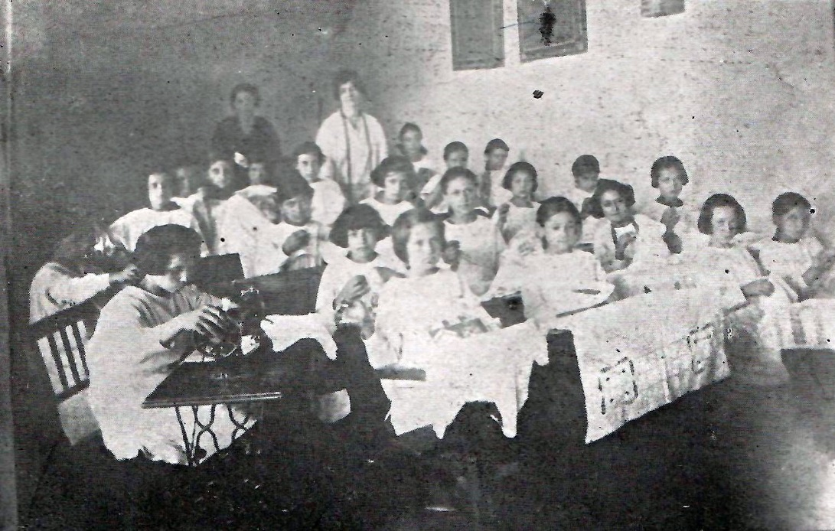
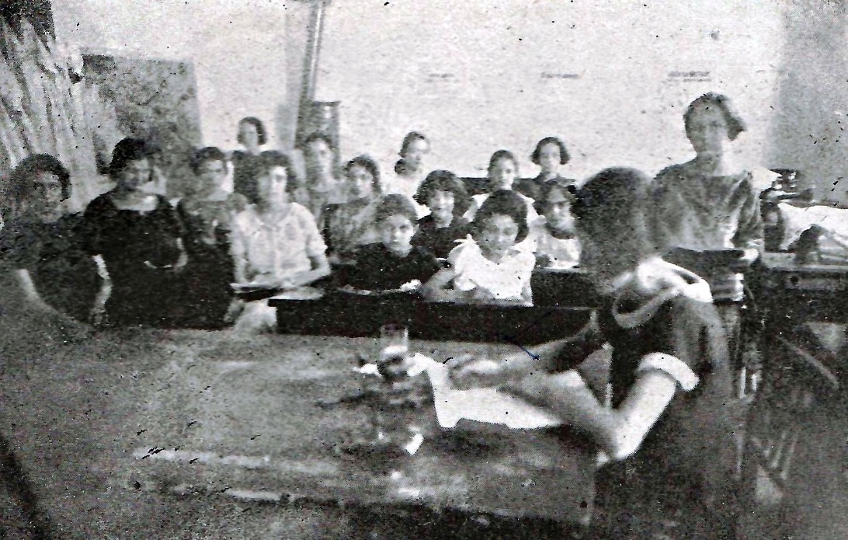
On Jelena’s initiative Seamstress school was started in 1919.
Due to lack of financial resources, the Society was forced to seek support from the Jewish community and city organizations.
The Sephardic Jewish community provided a space for school, the City government donated the furniture, while the American Red Cross bought 10 sewing machines.

Slide 22
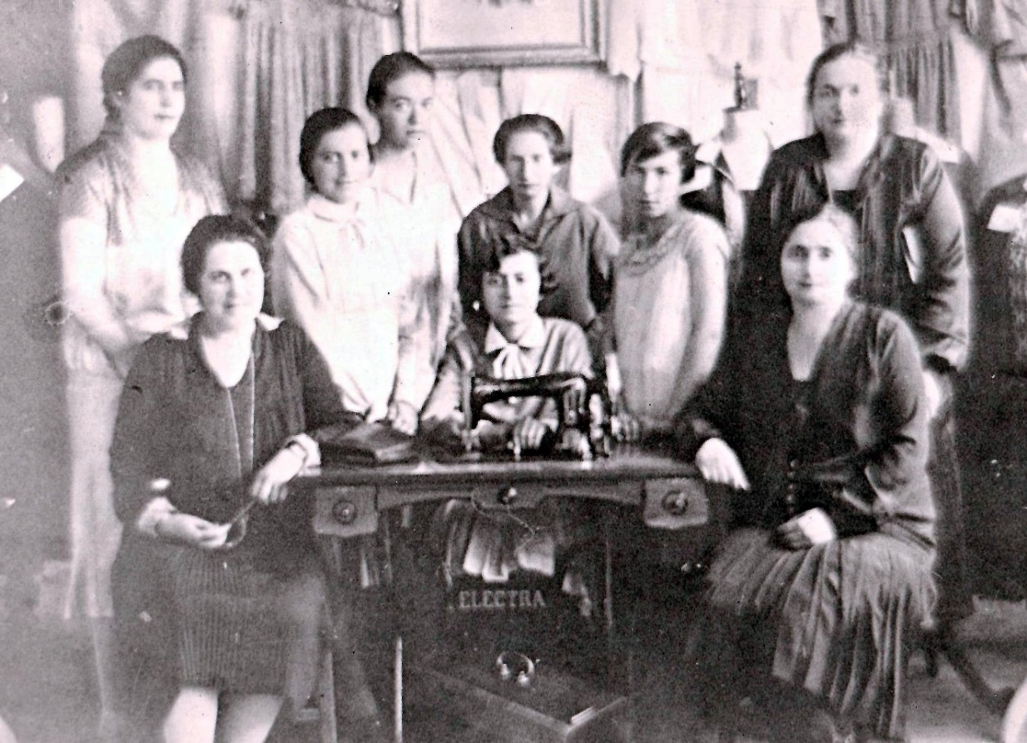
At the very beginning only 14 students enrolled the Seamstress school. In 1924 the number of registered students increased to 54.
Beside sewing they attended a religious classes, mathematics and Serbian language.
During the school years, students were given some profit earned by clothes sold, but most of produced items had been donated to the poor fellow citizens.
Jelena Demajo, Sofija Almuli and Matilda Baruh with students of Seamstress school

Slide 23
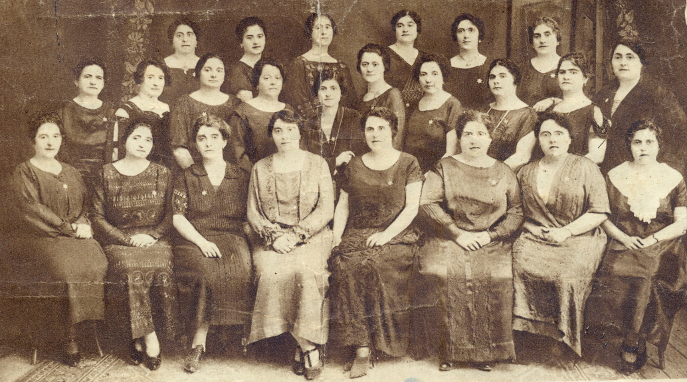
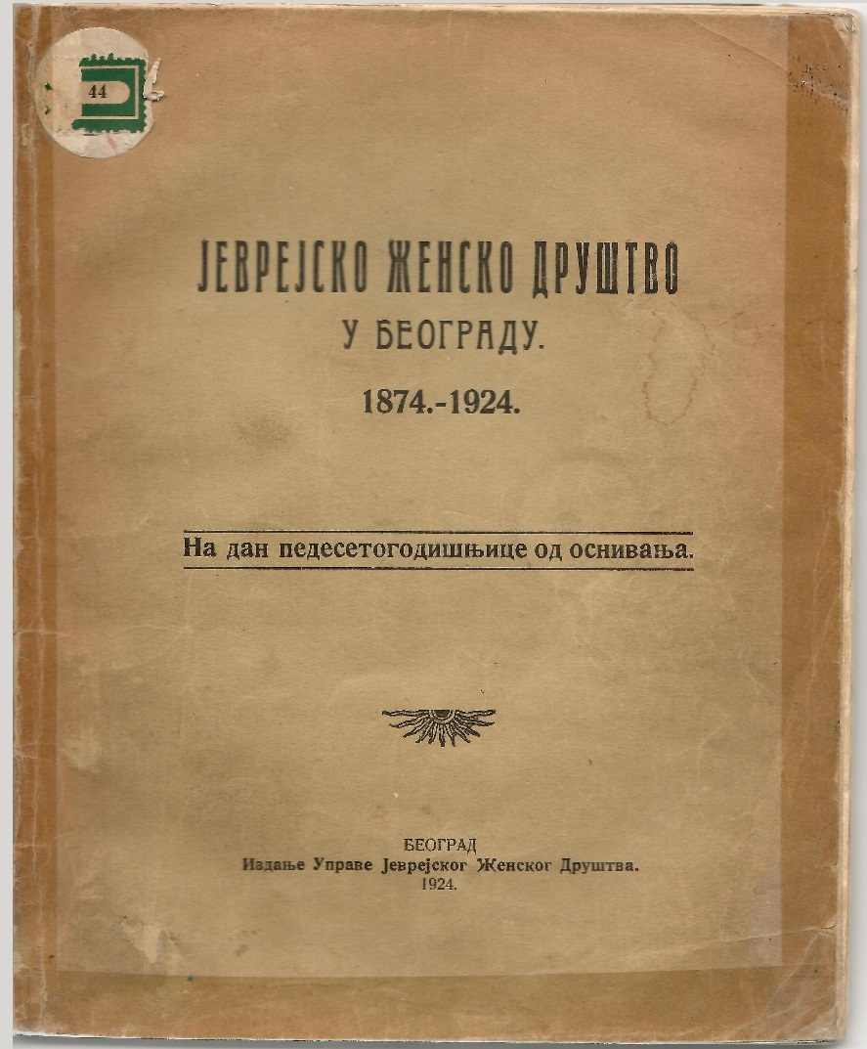
The 50th anniversary of the Jewish Women’s Society marked with public celebration.
On this occasion the Commemorative book of the Jewish Women’s Society was published. This book represents the most significant source of information about activities of the Society.

Slide 24
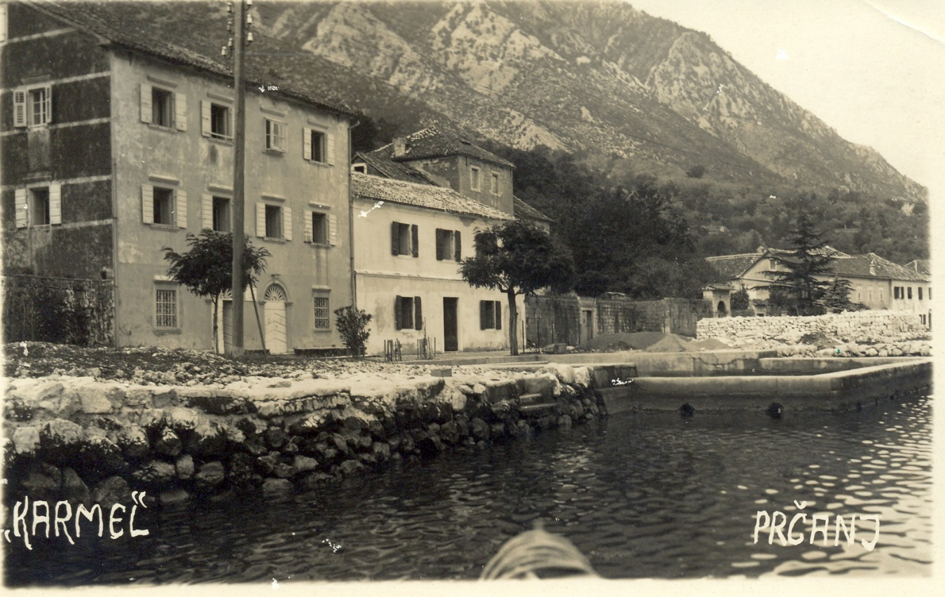
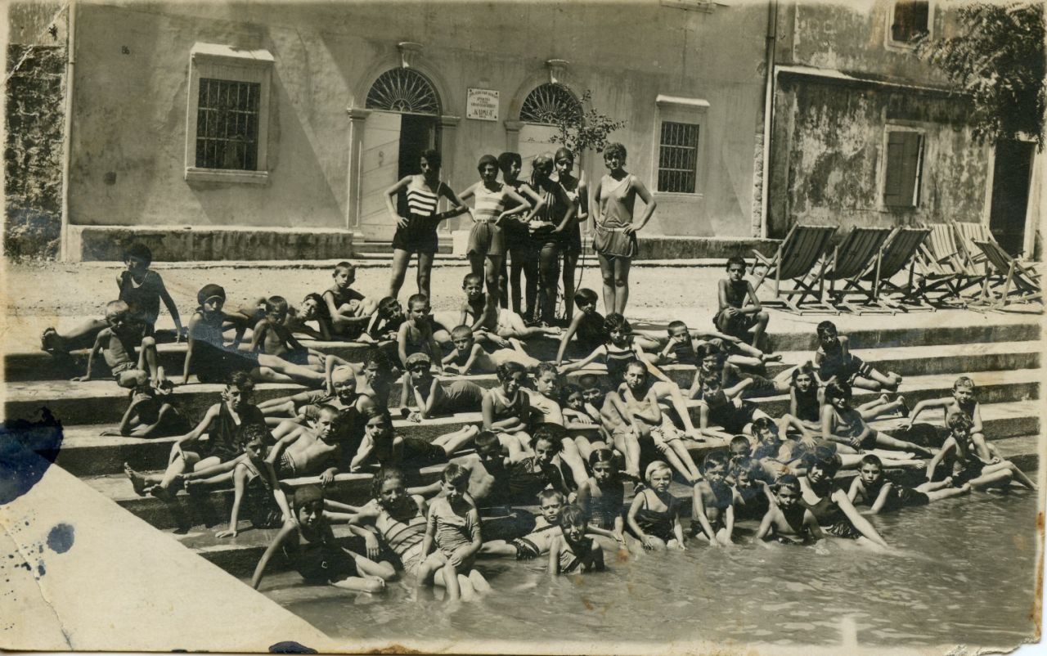
In 1926, the Jewish Women’s Society opened the Children’s recovery resort “Karmel” in Prčanj, a small town along the Bay of Kotor (Montenegro).

Slide 25
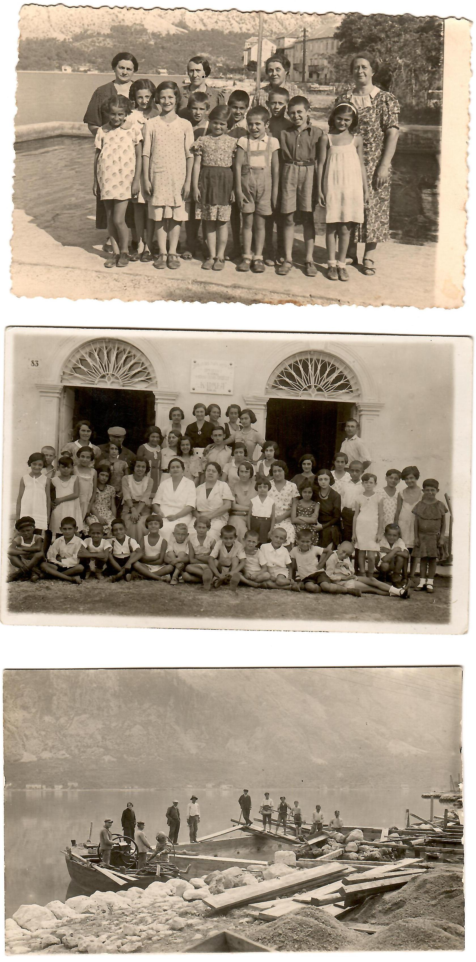
Resort was a property of the Jewish Women’s Society.
Organizing stay for children at seaside, providing health care, nutrition and educational work were the primary activities.

Slide 26
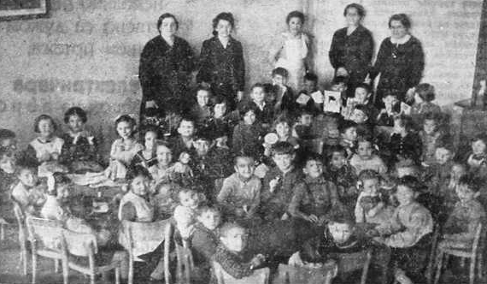
With great effort, the Jewish Women’s Society succeeded to erect a building for their own use in Belgrade in 1938. Initially, it homed orphans. Not too long after, the kindergarten and hospital were opened there.

Slide 27
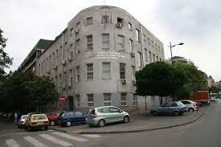
At the beginning of June 1941 this modern building turned into Jewish hospital by Germans and Serbian quisling authorities.
The hospital operated there until the mid of March 1942, when the stuff and patients, about 800, were suffocated in a gas-van called “Dušegupka”.
Today, the building houses The Faculty for Special Education and Rehabilitation.

Slide 28
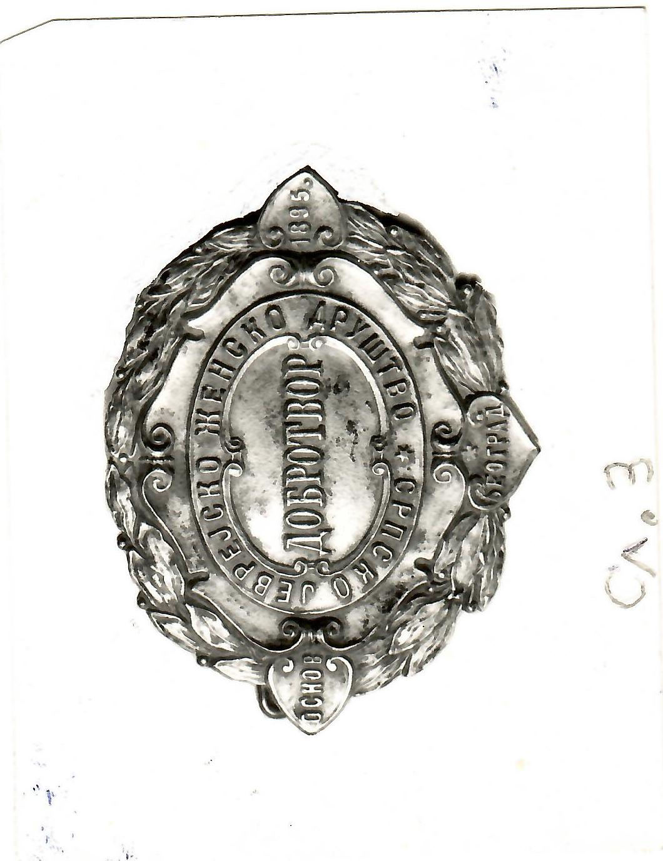
Humanitas
(Dobrotvor)
The Belgrade’s Ashkenazi women established their own society named Humanitas in 1895.
It was philanthropic organization that helped
girls to prepare a dowry for marriage, women during their maternity period, widows, sick and needy (girls up to 14 years old, boys up to 12 years old).

Slide 29
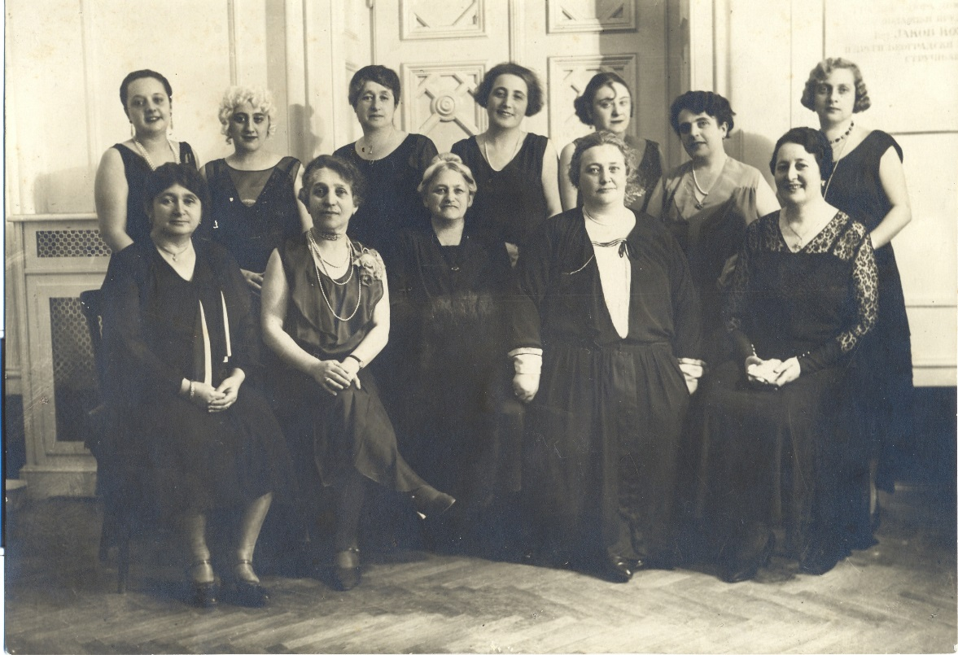
Jelena Hirš was the first president.
In 1935 she was succeeded by Eliza Lebl-Feldman.
Active members were also
Ema Volfner,
Rozalija Bril, Janka Lebl,
Lujza Miler, Matilda Avramovic, Elvira Bah, Regina Flajšer,
Ruža Pops, Tereza Horivic, and many others.

Slide 30
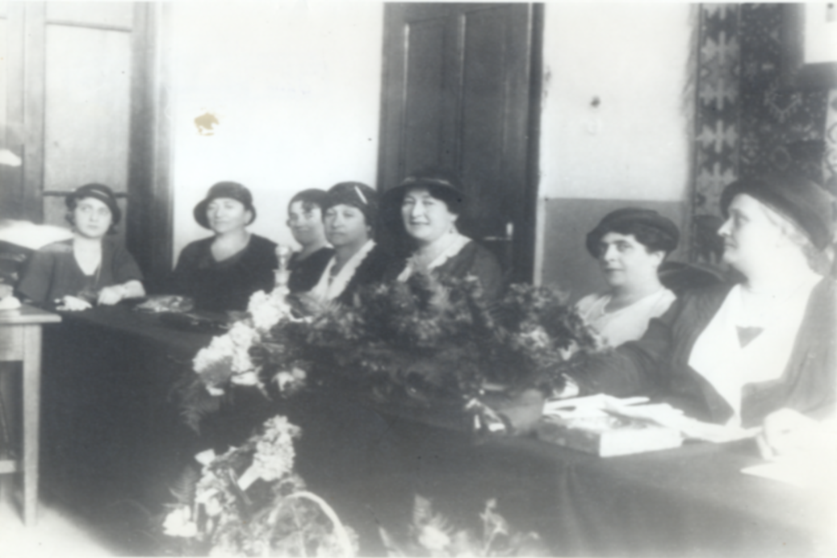
Ashkenazi women although fewer than Sephardic had the same level of activities.
They organized numerous successful fundraising banquet to help poor Belgrade citizens and soldiers during Balkans and WWI.
After the 1929 Arab riots in Palestine (Meora'ot Tarpat), when 133 Jews were killed and between 198–241 others were injured, commemorative ceremony was held by Ashkenazi women.
Marking the 70th anniversary of Theodor Herzl’s birth they were involved with local Zionist organization in giving a performance by celebrated cantors and famous musicians.

Slide 31
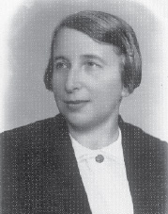
Paulina Lebl – feminist, translator, literary critic, professor of literature, founder of the Yugoslav Association of University Educated Women, and one of the most educated women in Yugoslavia – was born in Belgrade and grew up in the city’s Ashkenazi community.
In 1913 Paulina graduated from the Faculty of Philosophy, classic department (Serbian and French literature).
In 1920 she married David Albala, a physician, Zionist leader and president of Belgrade’s Sephardi community.
From 1919 through 1939, Lebl-Albala wrote essays, literary discussions, criticism, travel articles, translations and other contributions which were published in newspapers and journals.
In 1940, she moved to Washington, joining her husband at the Yugoslav Embassy.
Paulina Lebl Albala
1891, Belgrade – 1967, Los Angeles

Slide 32
Federation of Jewish Women’s Society of the Kingdom of Yugoslavia
At one of the joint sessions of Jewish Women’s Society and Humanitas the idea crystalized to establish a Federation of Jewish Women’s Associations of the Kingdom of Yugoslavia.
In November 1924, the first congress of Jewish women’s societies of all of Yugoslavia was held in Belgrade.
Next step was to join International Jewish Women’s Societies, with desire to do a benefit of Jews all over the world.

Slide 33
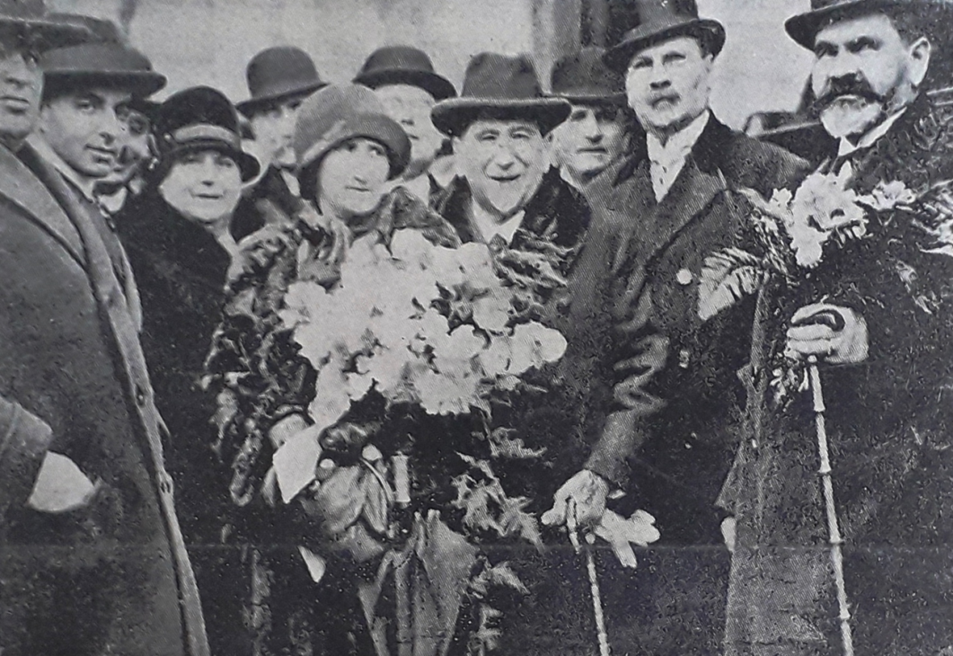
WIZO – Women International Zionist Organization
Jewish women of the Kingdom of Yugoslavia were very aware of the importance of Zionist movement that espouses the re-establishment of a Jewish state in the territory defined as the historic Land of Israel.
The first Women Zionist Organization was founded in Zagreb in 1924.
Four years later, during Dr Nahum Sokolow, the Zionist leader, and his daughter Dr Celina Sokolow visit of Belgrade, branch of WIZO was formed in Belgrade, too.

Slide 34
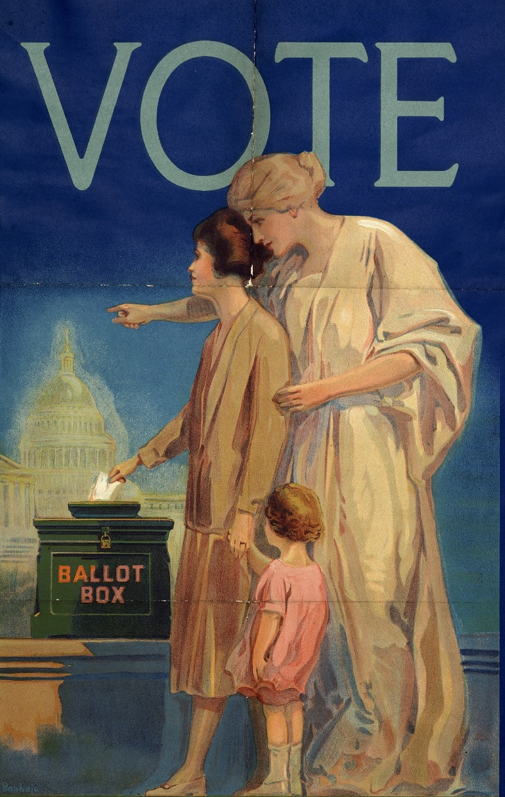
Women's suffrage
The question of Yugoslav women’s suffrage arose in 1930’s.
Each activist’s unique personality and her community activity led to women’s ability to vote, but not to be elected.
Belgrade’s Jewish women were first allowed to vote in Ashkenazi community in 1933, and 3 years later in Sephardic community.

Slide 35
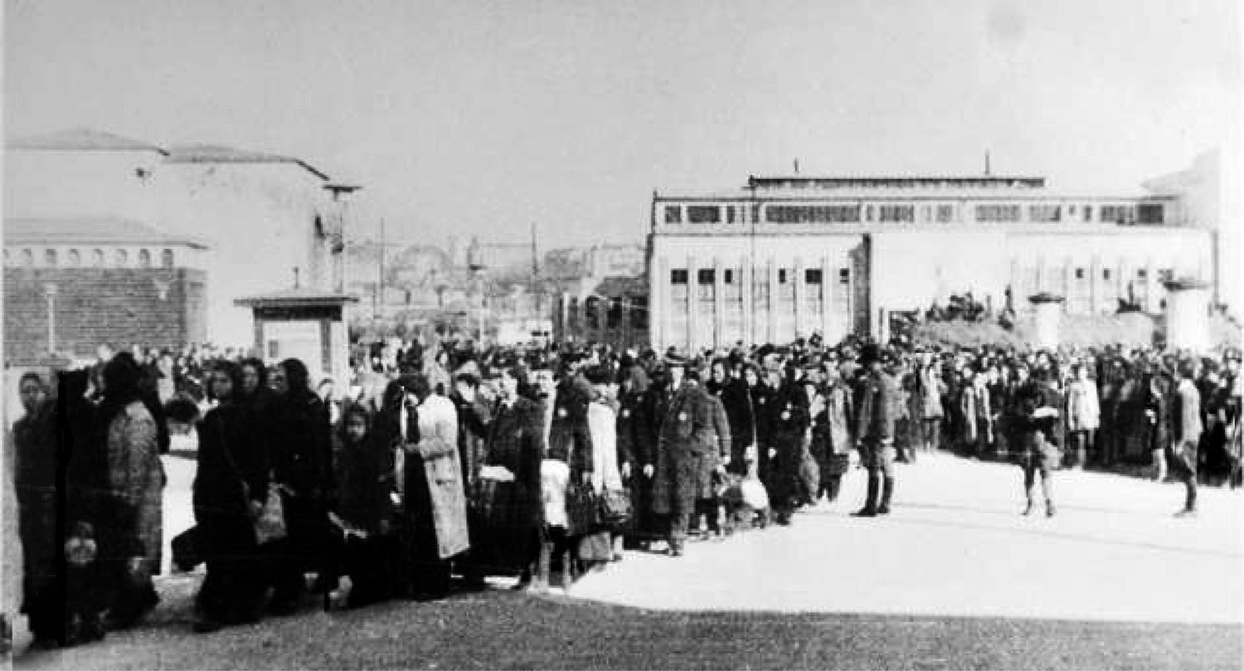
Activity of the Jewish Women’s Societies was interrupted by war.
On the 6th of April 1941, the German Air Fleet (Luftwaffe) bombed Belgrade with a special brutality.
Germans organized the military occupation administration which included an extended repressive apparatus.
The Belgrade Jews were being brought into Sajmište camp, December 1941
Security Police – Gestapo, within which the Police Department for Jewish Affairs, “Judenreferat”, was established immediately. Very soon Belgrade’s fairgrounds was tranformed into a Jewish camp (Judenlager Semlin), and in just a few weeks, from April to May 1942, the Nazis killed 6,320 Jews, mostly women and children, out of 6,400 Jewish inmates.

Slide 36

Presented by Barbara Panić
Curator at the Jewish Historical Museum, Belgrade

