Slide 1
KONFLIKT U IZRAELU maj 2021
gost : DaviD ( DARKO ) Shlezinger

Slide 2
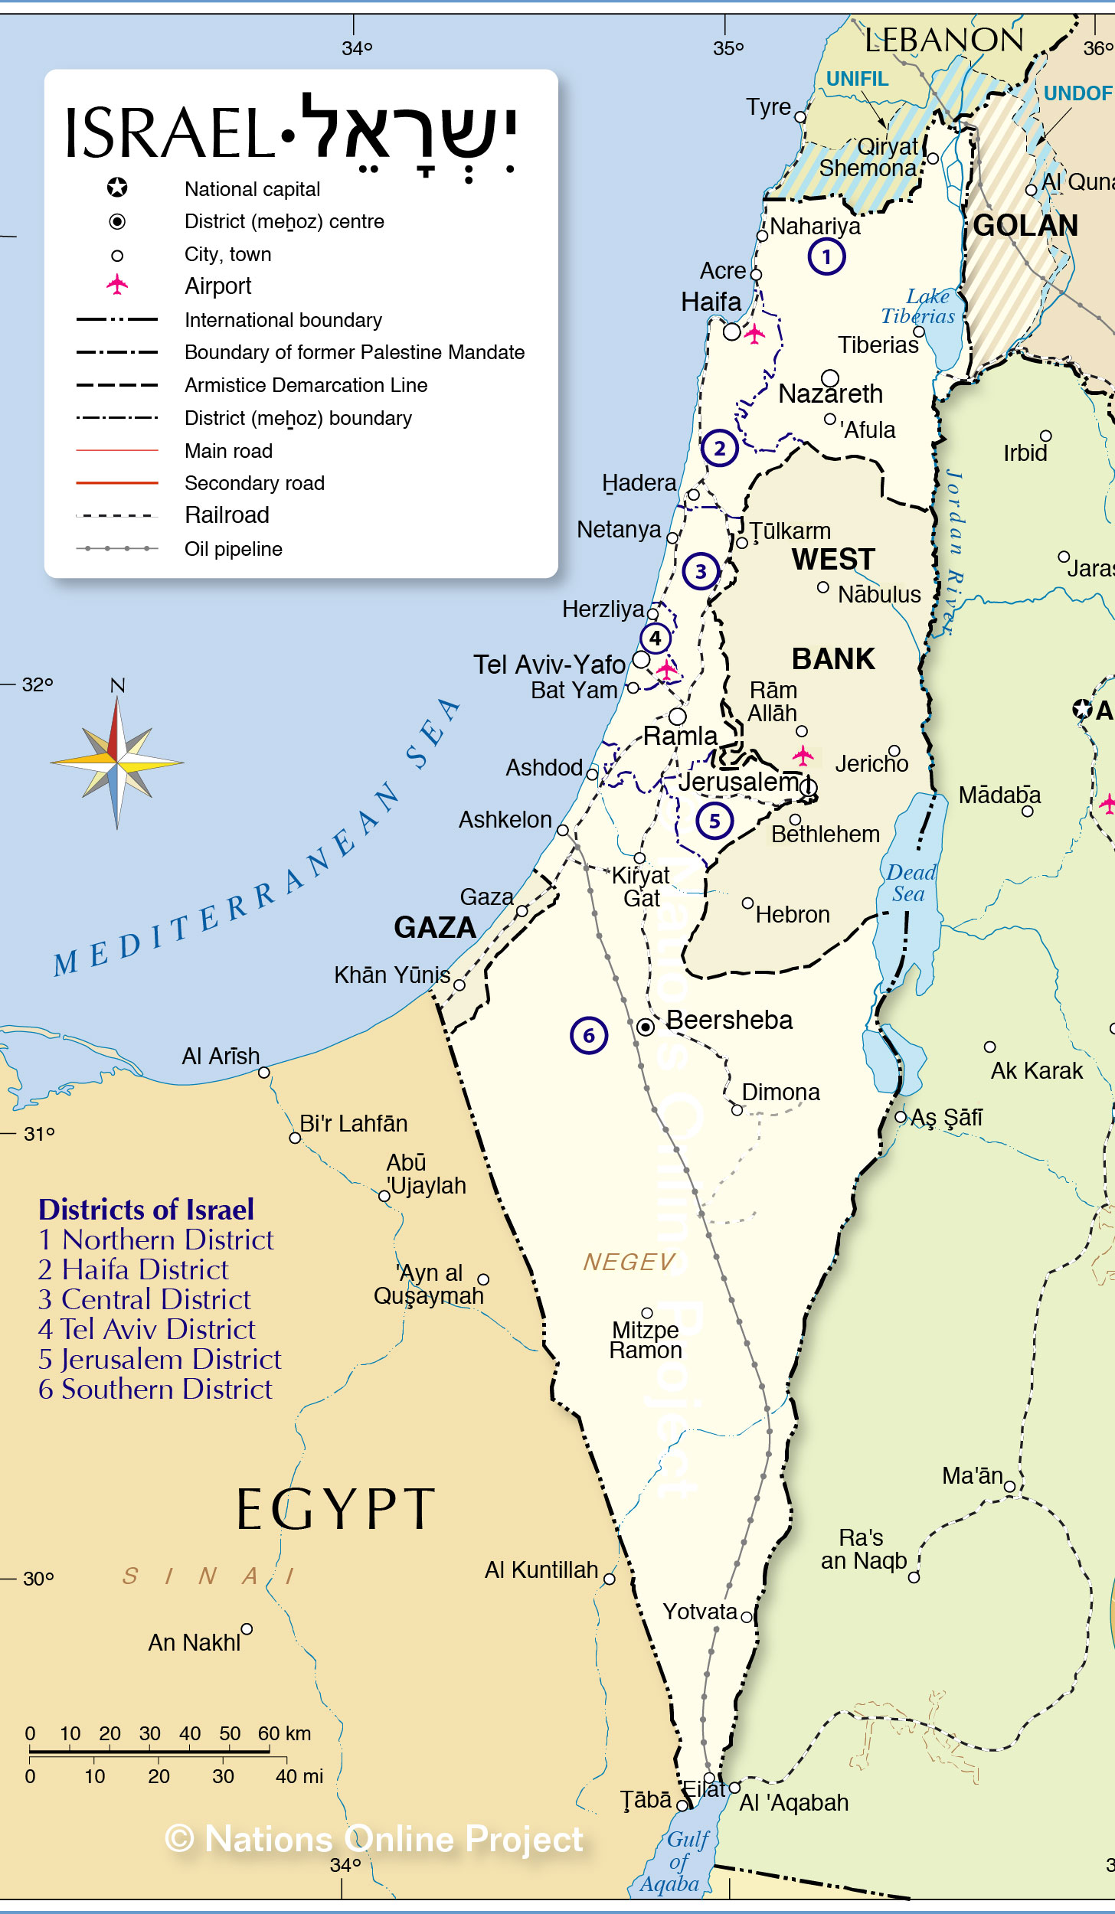
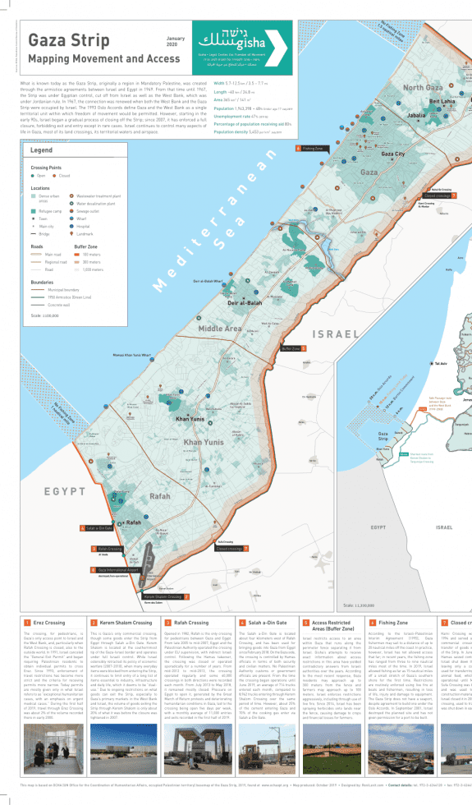
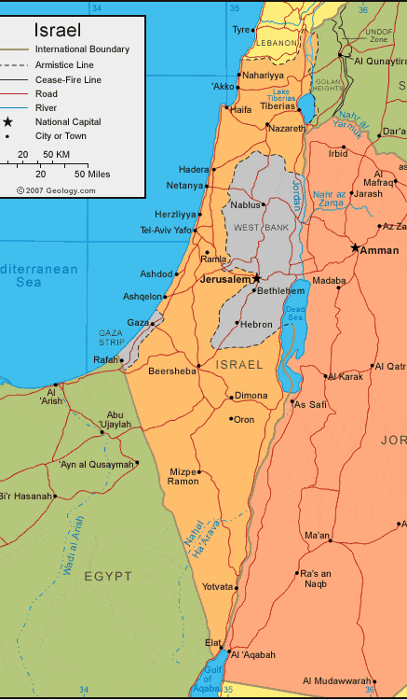

Slide 3
Politička dimenzija saradnje i sukoba Jevreja i Arapa
Vojni sukob IDF i HAMASA
Verska netrpeljivost Jevreja i Arapa

Slide 4
POLITIČKA SCENA IZRAELA
danas

Slide 5
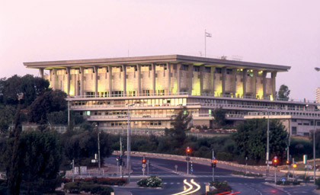
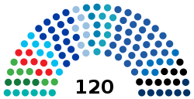
Likud (30)
Atid Ehad (1)
Shas (9)
Blue and White (8)
United Torah Judaism (7)
Degel HaTorah (4)
Agudat Yisrael (3)
Opposition (66)
Yesh Atid (17)
Yamina (7)
Labor (7)
Yisrael Beiteinu (7)
Religious Zionist (6)
Otzma Yehudit (1)
Noam (1)
Joint List (6)
Hadash (3)
Maki (2)
Independents (1)
Ta'al (2)
Balad (1)
New Hope (6)
Meretz (6)
Ra'am (4)

Slide 6
ZA KOGA GLASAJU IZRAELSKI ARAPI ????

Slide 7
RAAM
Hebrew name | הרשימה הערבית המאוחדת‎
Leader | Mansour Abbas
Chairman | Mansour Abbas
Founded | 1996
Ideology | Conservatism^{[1]} Israeli Arab interests Two-state solution Anti-Zionism Islamism^{[2][3][4]} Social conservatism^{[5][6]}
Political position | Big tent
National affiliation | Joint List (2015–2019; 2020–2021)
Seats in Knesset | 4 / 120
The party supports the two-state solution, and the creation of a Palestinian state in the West Bank and Gaza Strip, with East Jerusalem as its capital; and equal rights for Arab citizens of Israel.

Slide 8
Arab nationalism^{[2][3]}
Left-wing nationalism^{[4]}
Social democracy^{[5]}
Secularism^{[6][1]}
Pan-Arabism^{[7][8]}
Anti-Zionism^{[9]}
Balad is a political party^{[14]} whose stated purpose is the "struggle to transform the state of Israel into a democracy for all its citizens, irrespective of national or ethnic identity".^{[15]} It opposes the idea of Israel as a Jewish state, and supports its creating a new "binational" state.
Balad also advocates that the state of Israel recognize Arabs as a national minority, entitled to all rights that come with that status including autonomy in education, culture and media.^{[15]} Since the party's formation, it has objected to every proposed state budget.
The party supports the creation of two states based on pre-1967 borders, with the West Bank, Gaza Strip, and East Jerusalem to constitute a Palestinian state^{[16]} and returning Palestinians who left homes in Israel to where they were.

Slide 9
Leader | Ahmad Tibi
Ideology | Arab nationalism^{[1][2]} Israeli Arab interests Secularism^{[3][1][2]} Two-state solution

Slide 10
ZA KOGA GLASAJU PALESTINCI U GAZI I NA ZAPADNOJ OBALI??

Slide 11
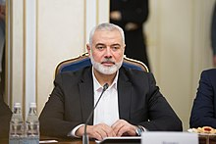
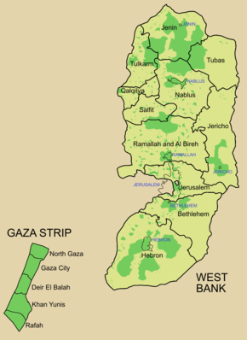
The 2021 Palestinian legislative election for the Palestinian Legislative Council, originally scheduled for 22 May 2021, according to a decree by President Mahmoud Abbas on 15 January 2021, was indefinitely postponed on 29 April 2021. Announcing the postponement on Palestinian TV, Abbas said "Facing this difficult situation, we decided to postpone the date of holding legislative elections until the participation of Jerusalem and its people is guaranteed."
Hamas | Ismail Haniyeh | 73
Fatah | Mahmoud Abbas^{[a]} | 43
PFLP | Ahmad Sa'adat^{[b]} | 3
PNI | Mustafa Barghouti | 2
Third Way | Salam Fayyad | 2
DFLP | Nayef Hawatmeh^{[c]} | 1^{[d]}
PPP | Bassam Al-Salhi | 1^{[e]}

Slide 12
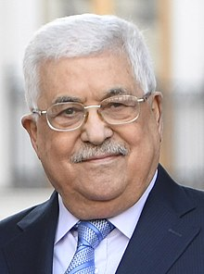
Fatah (Arabic: فتح‎ Fatḥ), formerly the Palestinian National Liberation Movement,^{[5]} is a Palestinian nationalist social democratic political party and the largest faction of the confederated multi-party Palestine Liberation Organization (PLO) and the second-largest party in the Palestinian Legislative Council (PLC). The President of the Palestinian Authority is a member of Fatah.

Slide 13
Hamas je najveća od nekoliko palestinskih ekstremističkih islamskih grupa.
Ime mu je akronim za „Islamski pokret otpora", a u tom obliku je nastao 1987. godine, posle početka prve palestinske intifade, iliti pobune, protiv izraelske okupacije Zapadne obale i pojasa Gaze.
Sopstvenom poveljom on se obavezao na uništenje Izraela.
Ismail Haniyeh

Slide 14
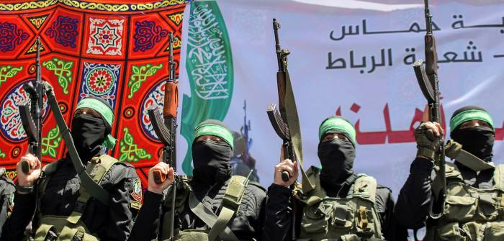

Slide 15
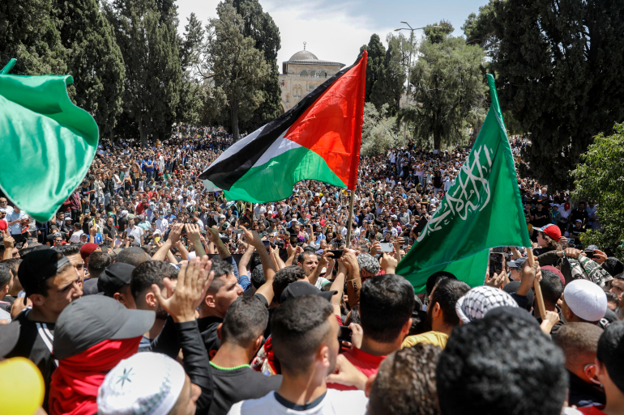
JERUSALIM MAJ 2021

Slide 16
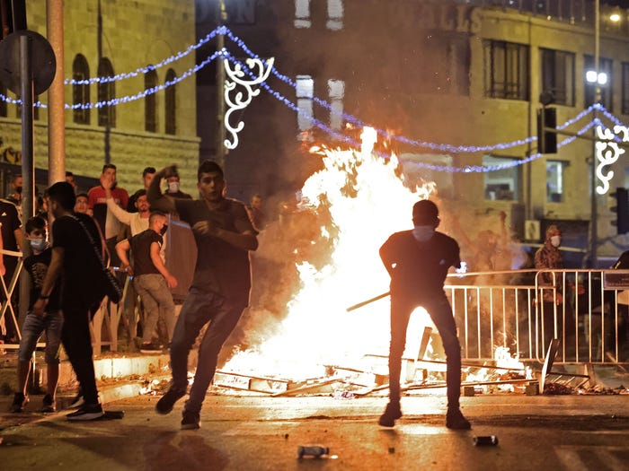
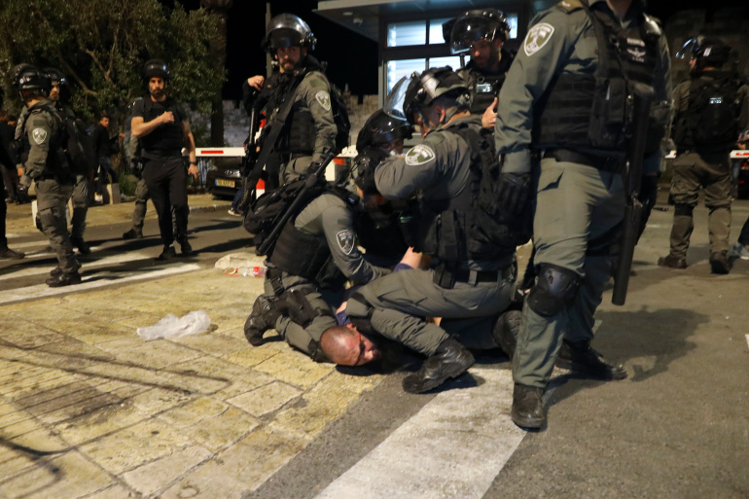

Slide 17
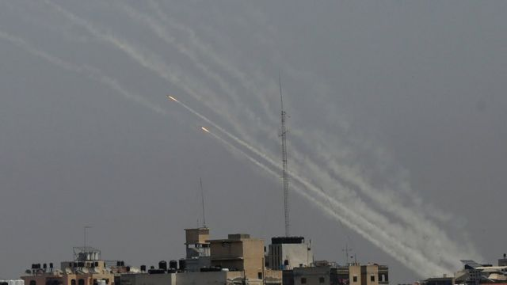
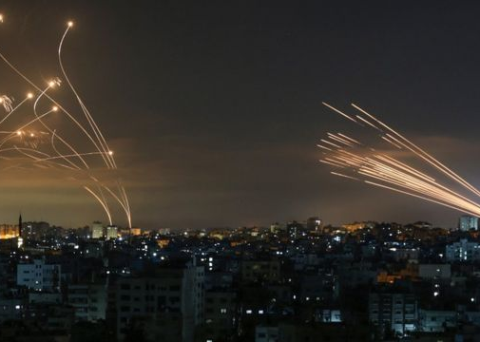

Slide 18
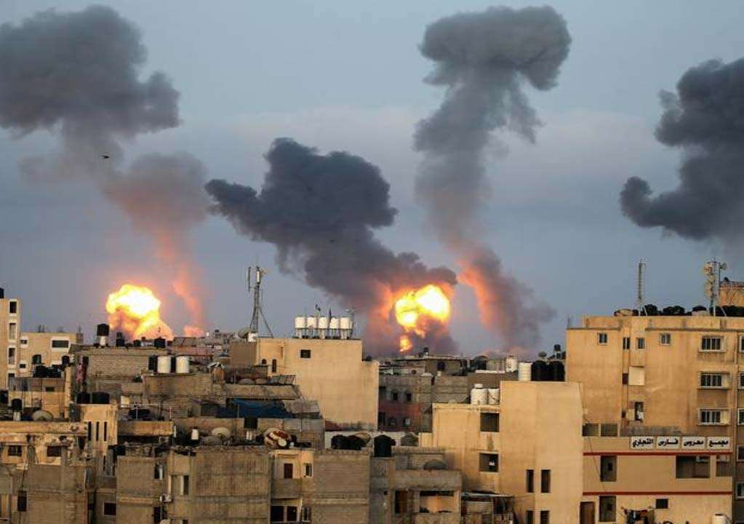

Slide 20
