Slide 1
Mjuzikl Violinista na krovu
Kristina Svam

Slide 2
Shtetl

Slide 3
Over Vitebsk, 1913 by Marc Chagall

Slide 4
Marc Chagall | The Marketplace, Vitebsk | The Metropolitan Museum of Art

Slide 5
The Wedding," by Marc Chagall | Painting

Slide 6
Mjuzikl “ Violinista na krovu”

Slide 7
Mjuzikl “ Violinista na krovu” SNP N. Sad

Slide 8
Mjuzikl “ Violinista na krovu” SNP N. Sad

Slide 9
Klecmer bend početak 20. veka

Slide 10
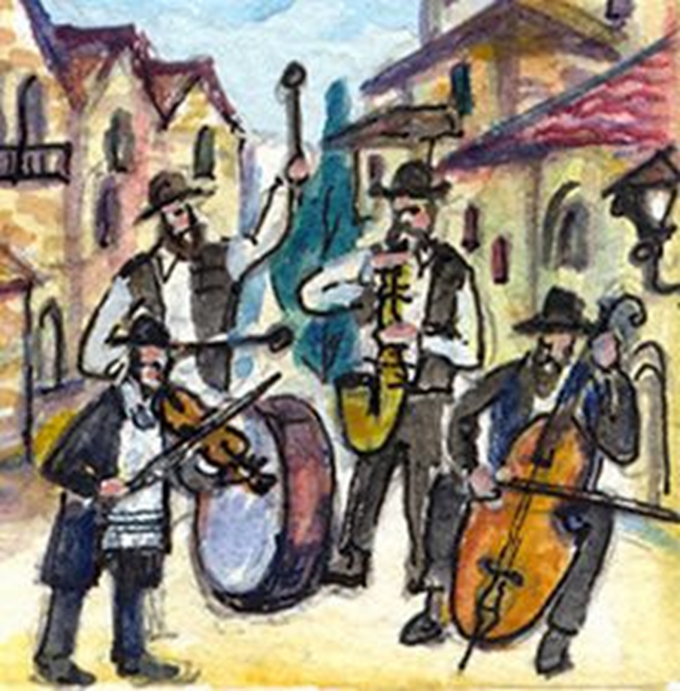
Klezmer band painting, Artist Unknown.

Slide 11
ŠAGAL / Mark Chagall – Green Violinist, 1923-24

