Slide 1
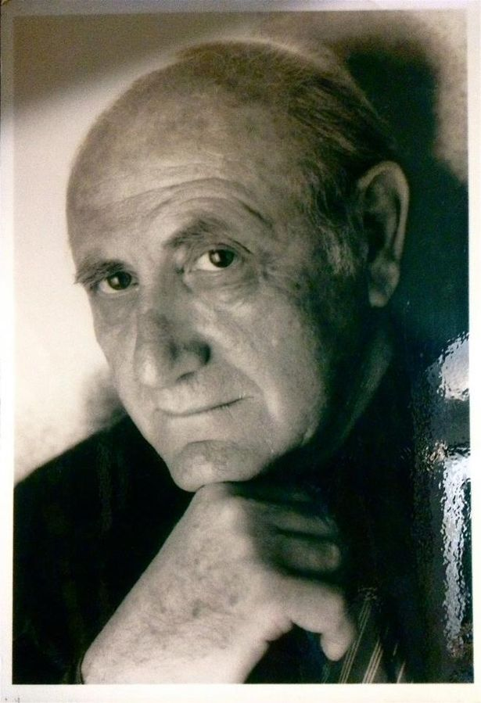
Peter Zvi Malkin
Peter Zvi Malkin was a celebrated Mossad agent who was part of the team that captured Adolf Eichmann in Argentina and brought him back to Israel to stand trial

Slide 2
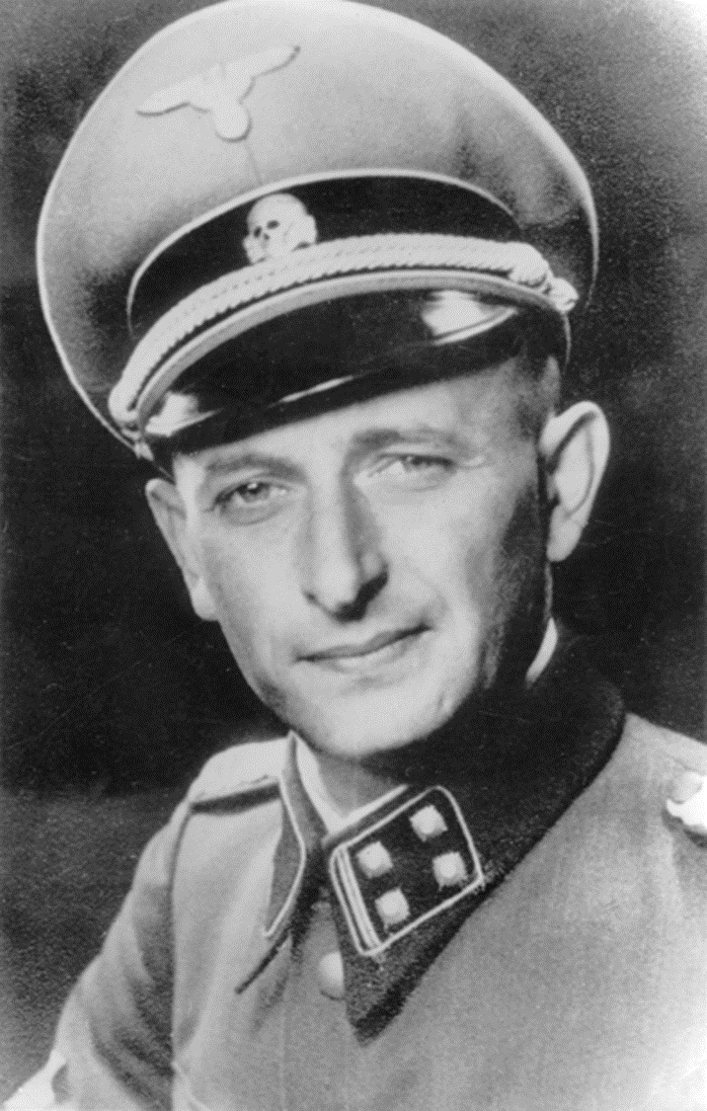
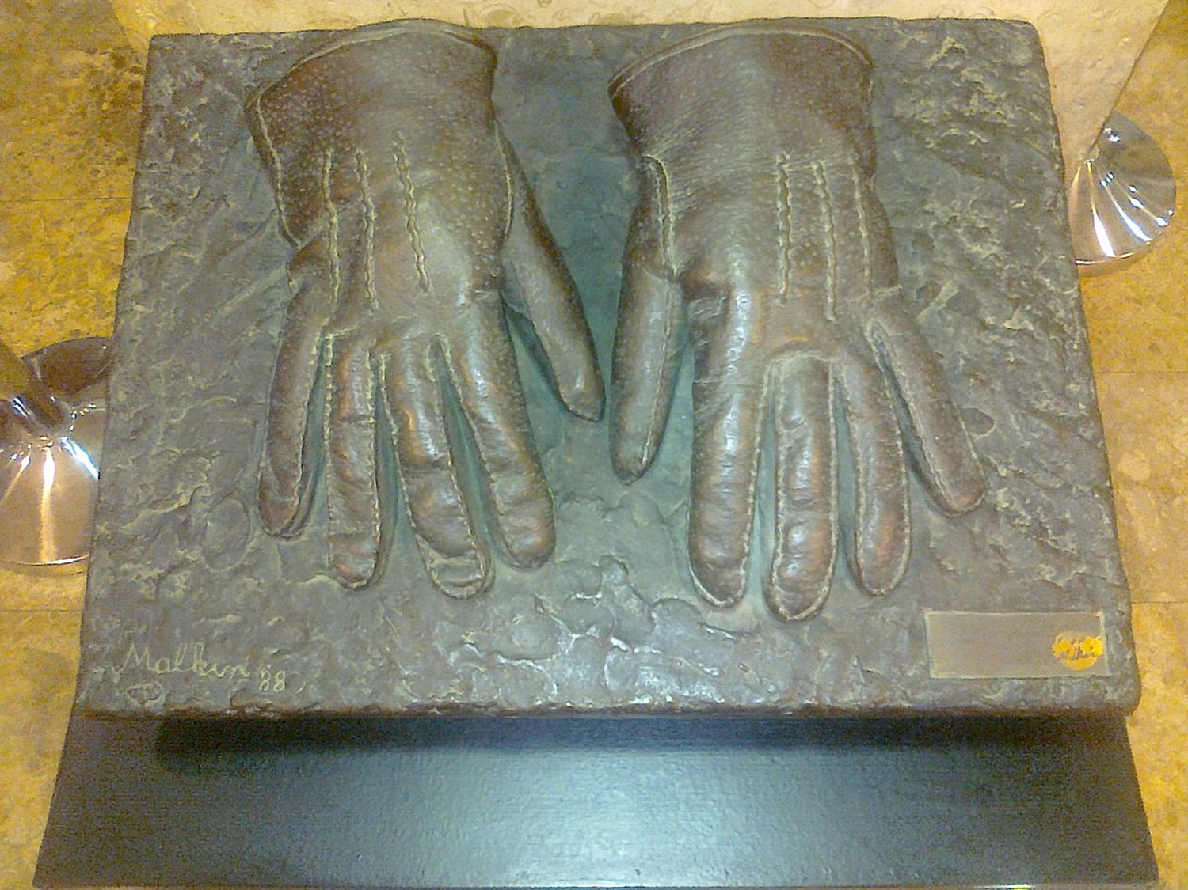

Slide 3
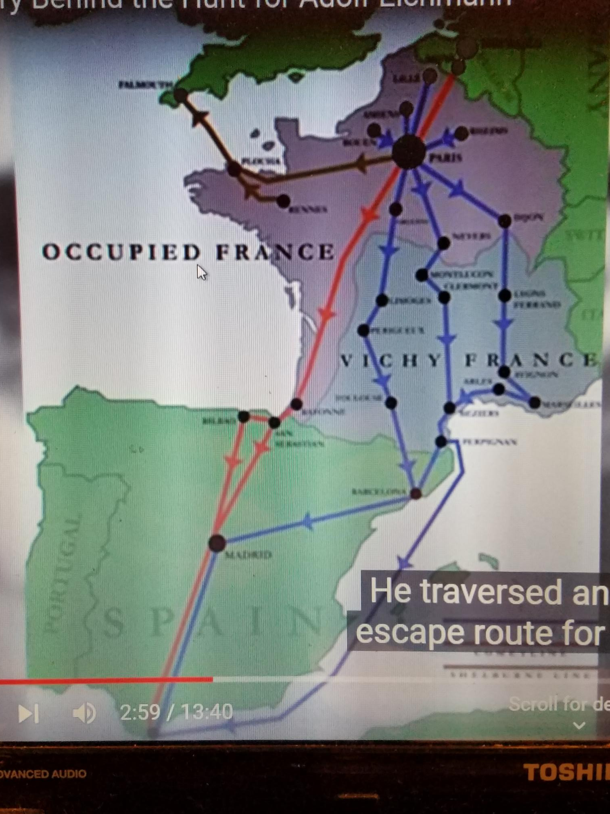
Skrivanje po Evropi

Slide 4
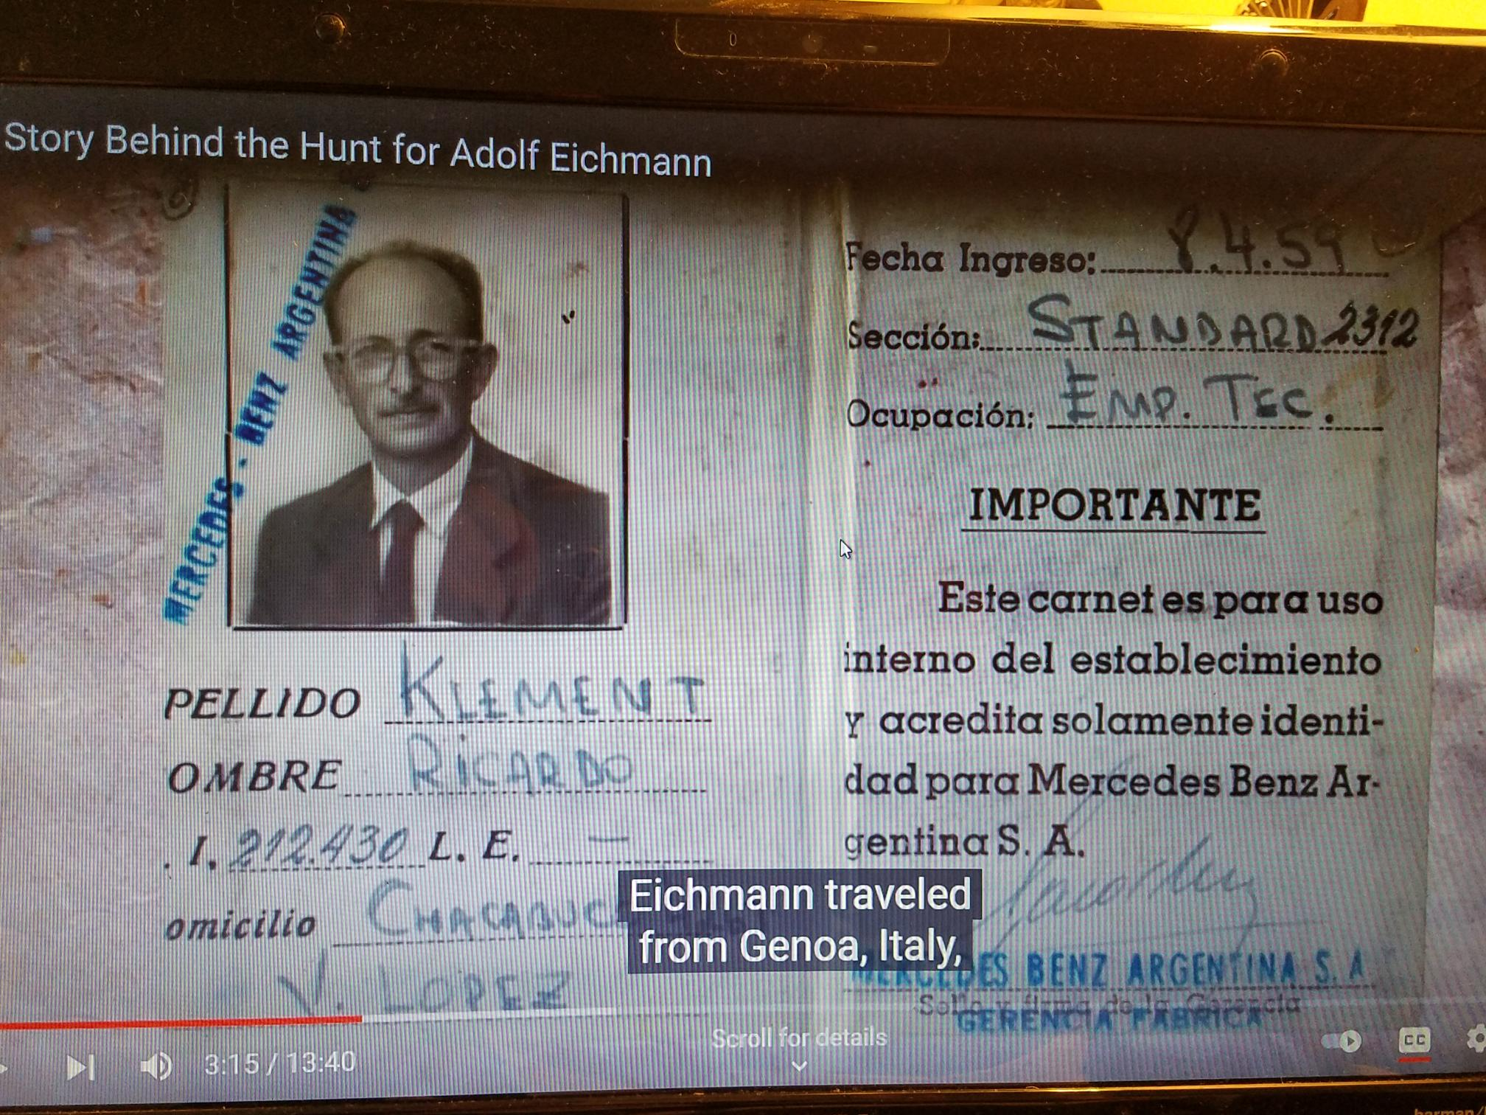
Lažna dokumenta za put u Argentinu

Slide 5
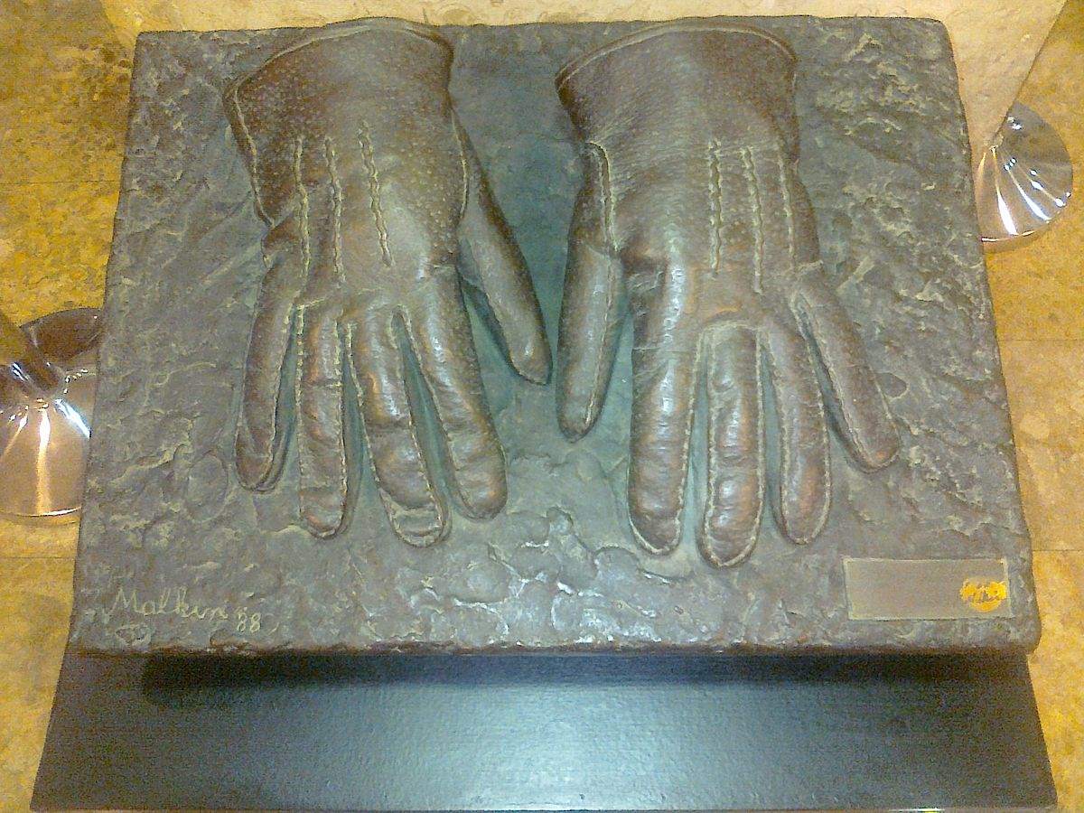

Slide 7
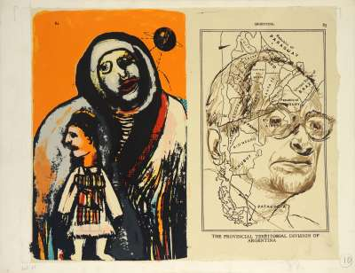

Slide 8
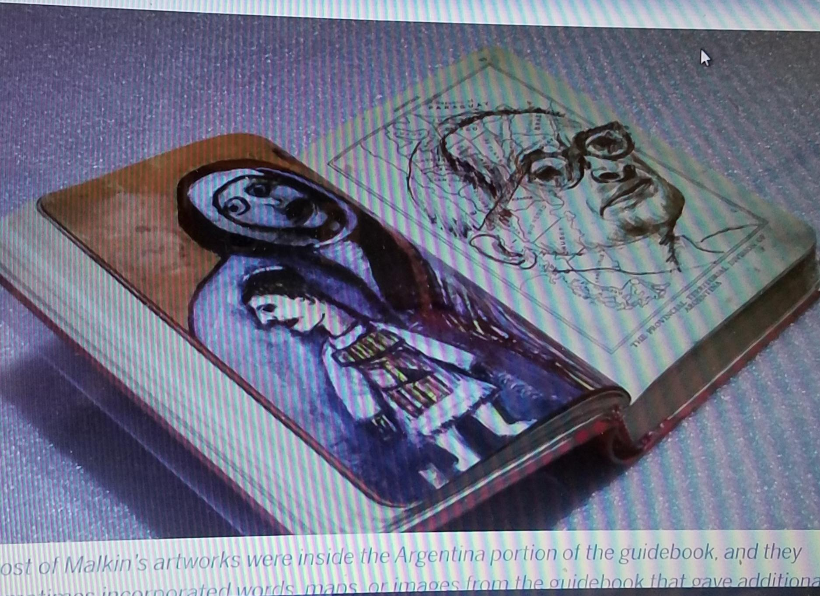
Crteži na stranicama
tur. bedekera

Slide 9
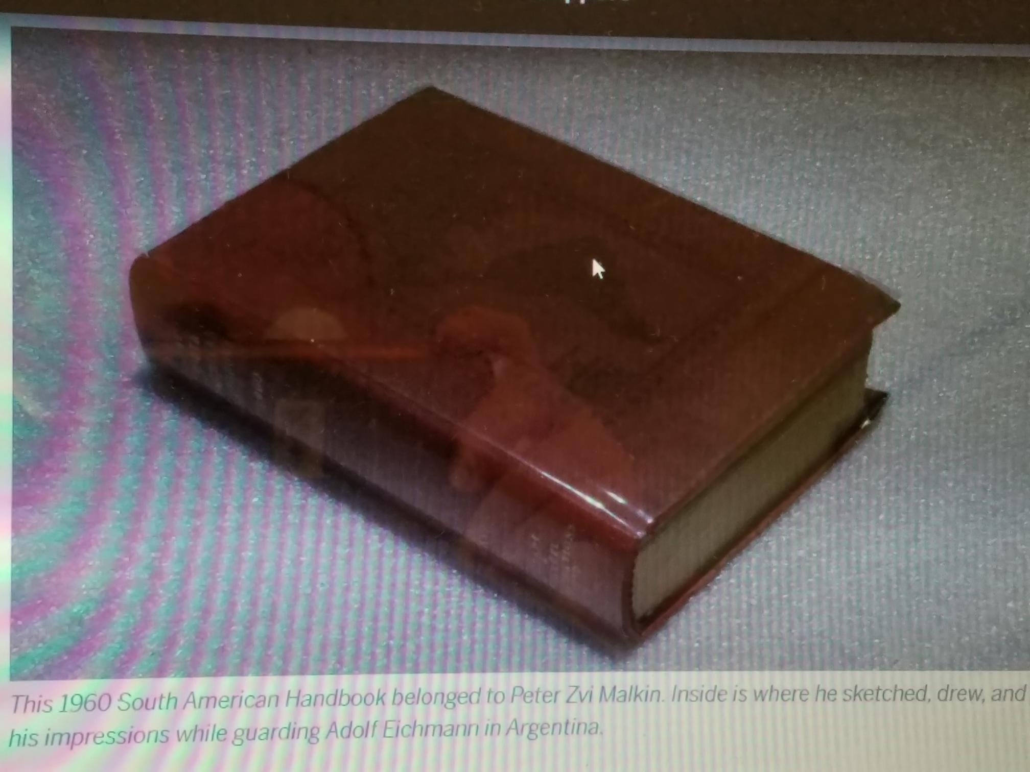
Turisticki vodič

Slide 10
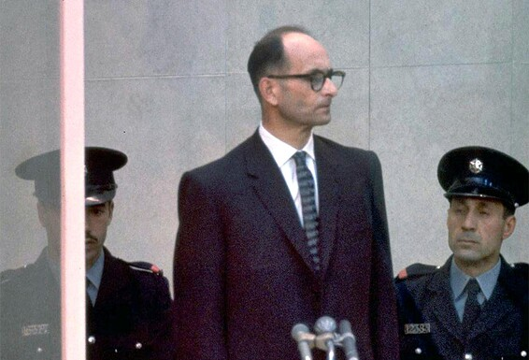
Mission implausible: The story of the police unit that protected Eichmann

Slide 11
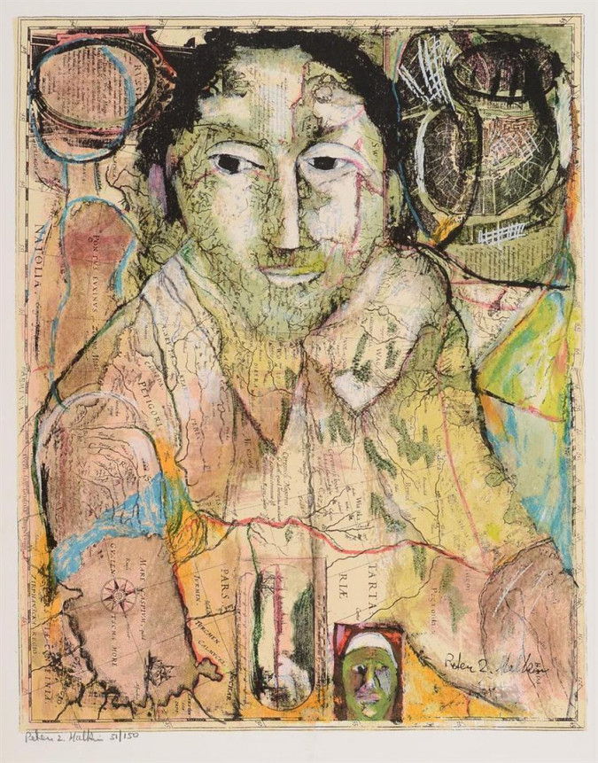

Slide 12
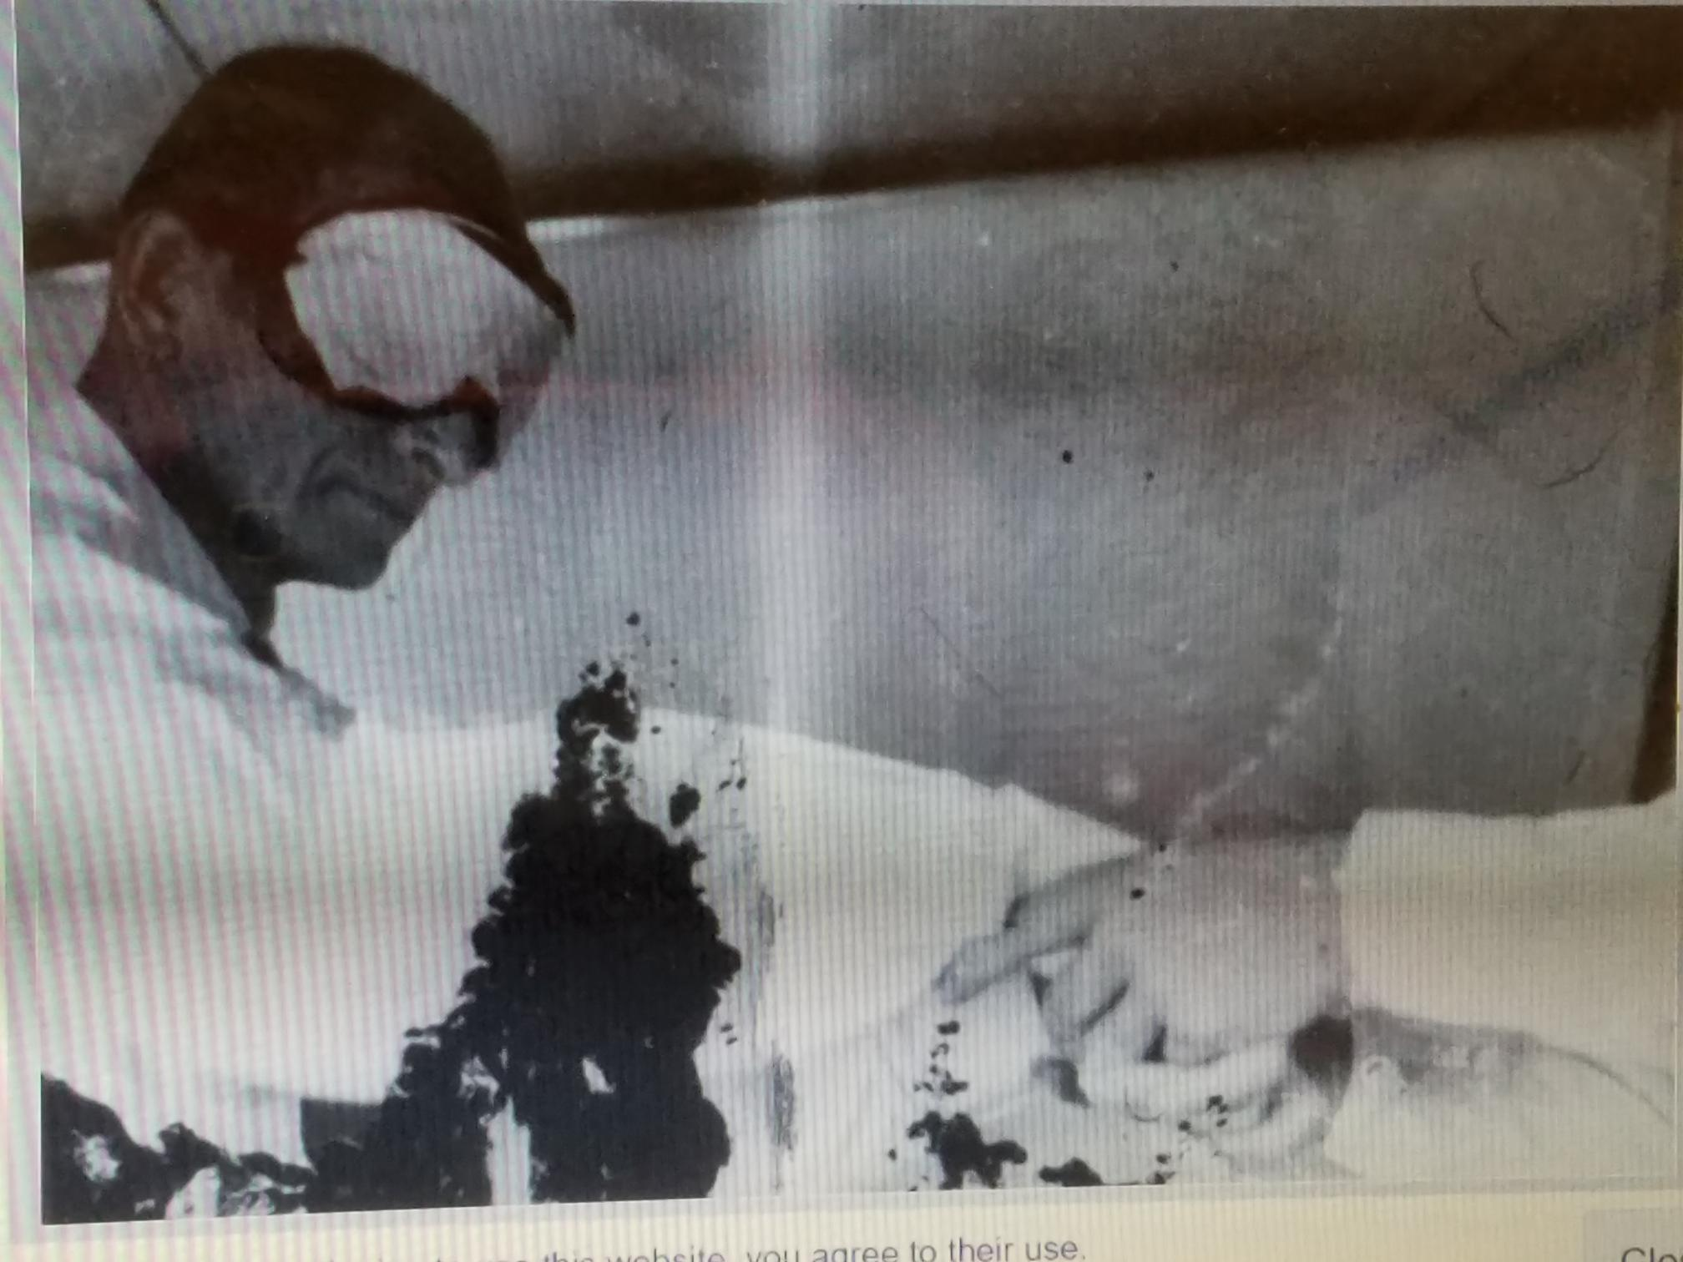
Švercovanje Ajhmana u
avion za Izrael

Slide 13
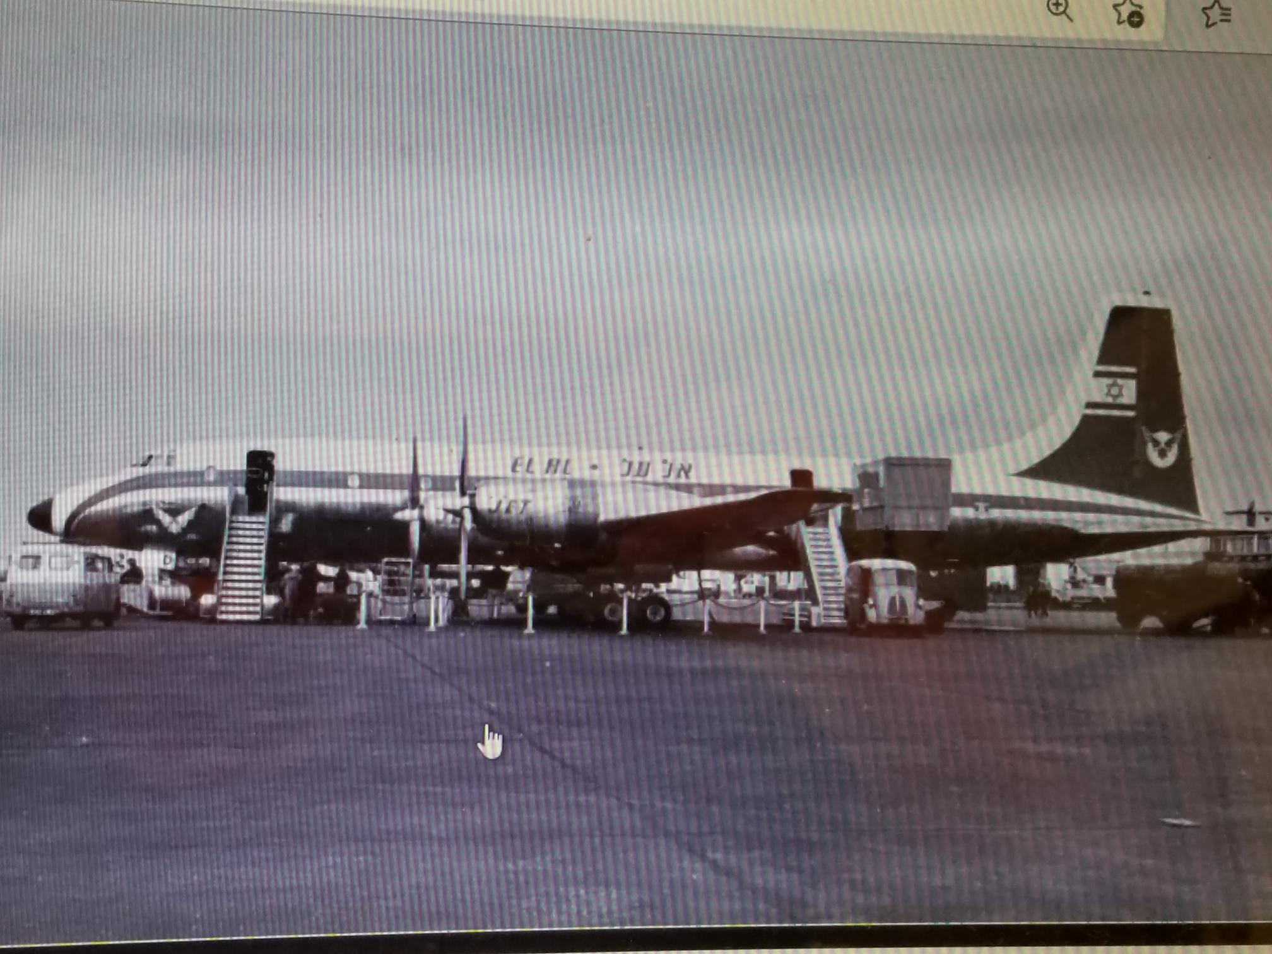
...u ovaj avion

Slide 14
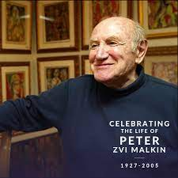

Slide 15
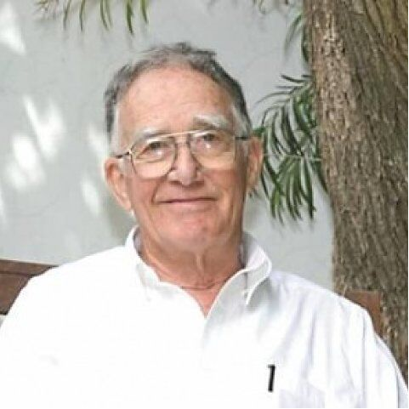
Cvi Aharoni

Slide 16
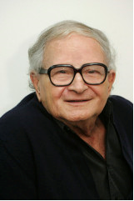
Rafi Eitan

Slide 17
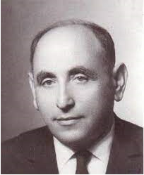
isar arel

Slide 18
Kraj

