Slide 1
Istočni Jevreji
Dusko Mihalek

Slide 3
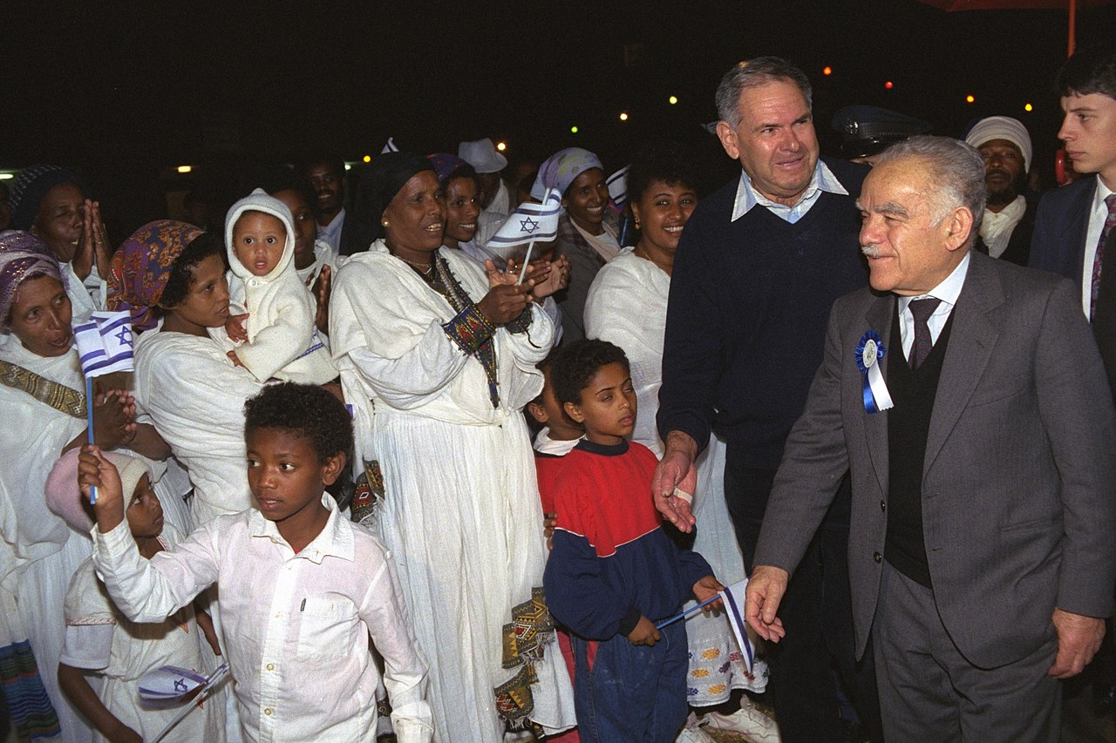

Slide 4
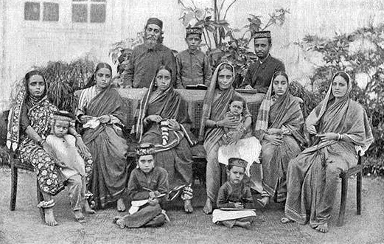

Slide 5
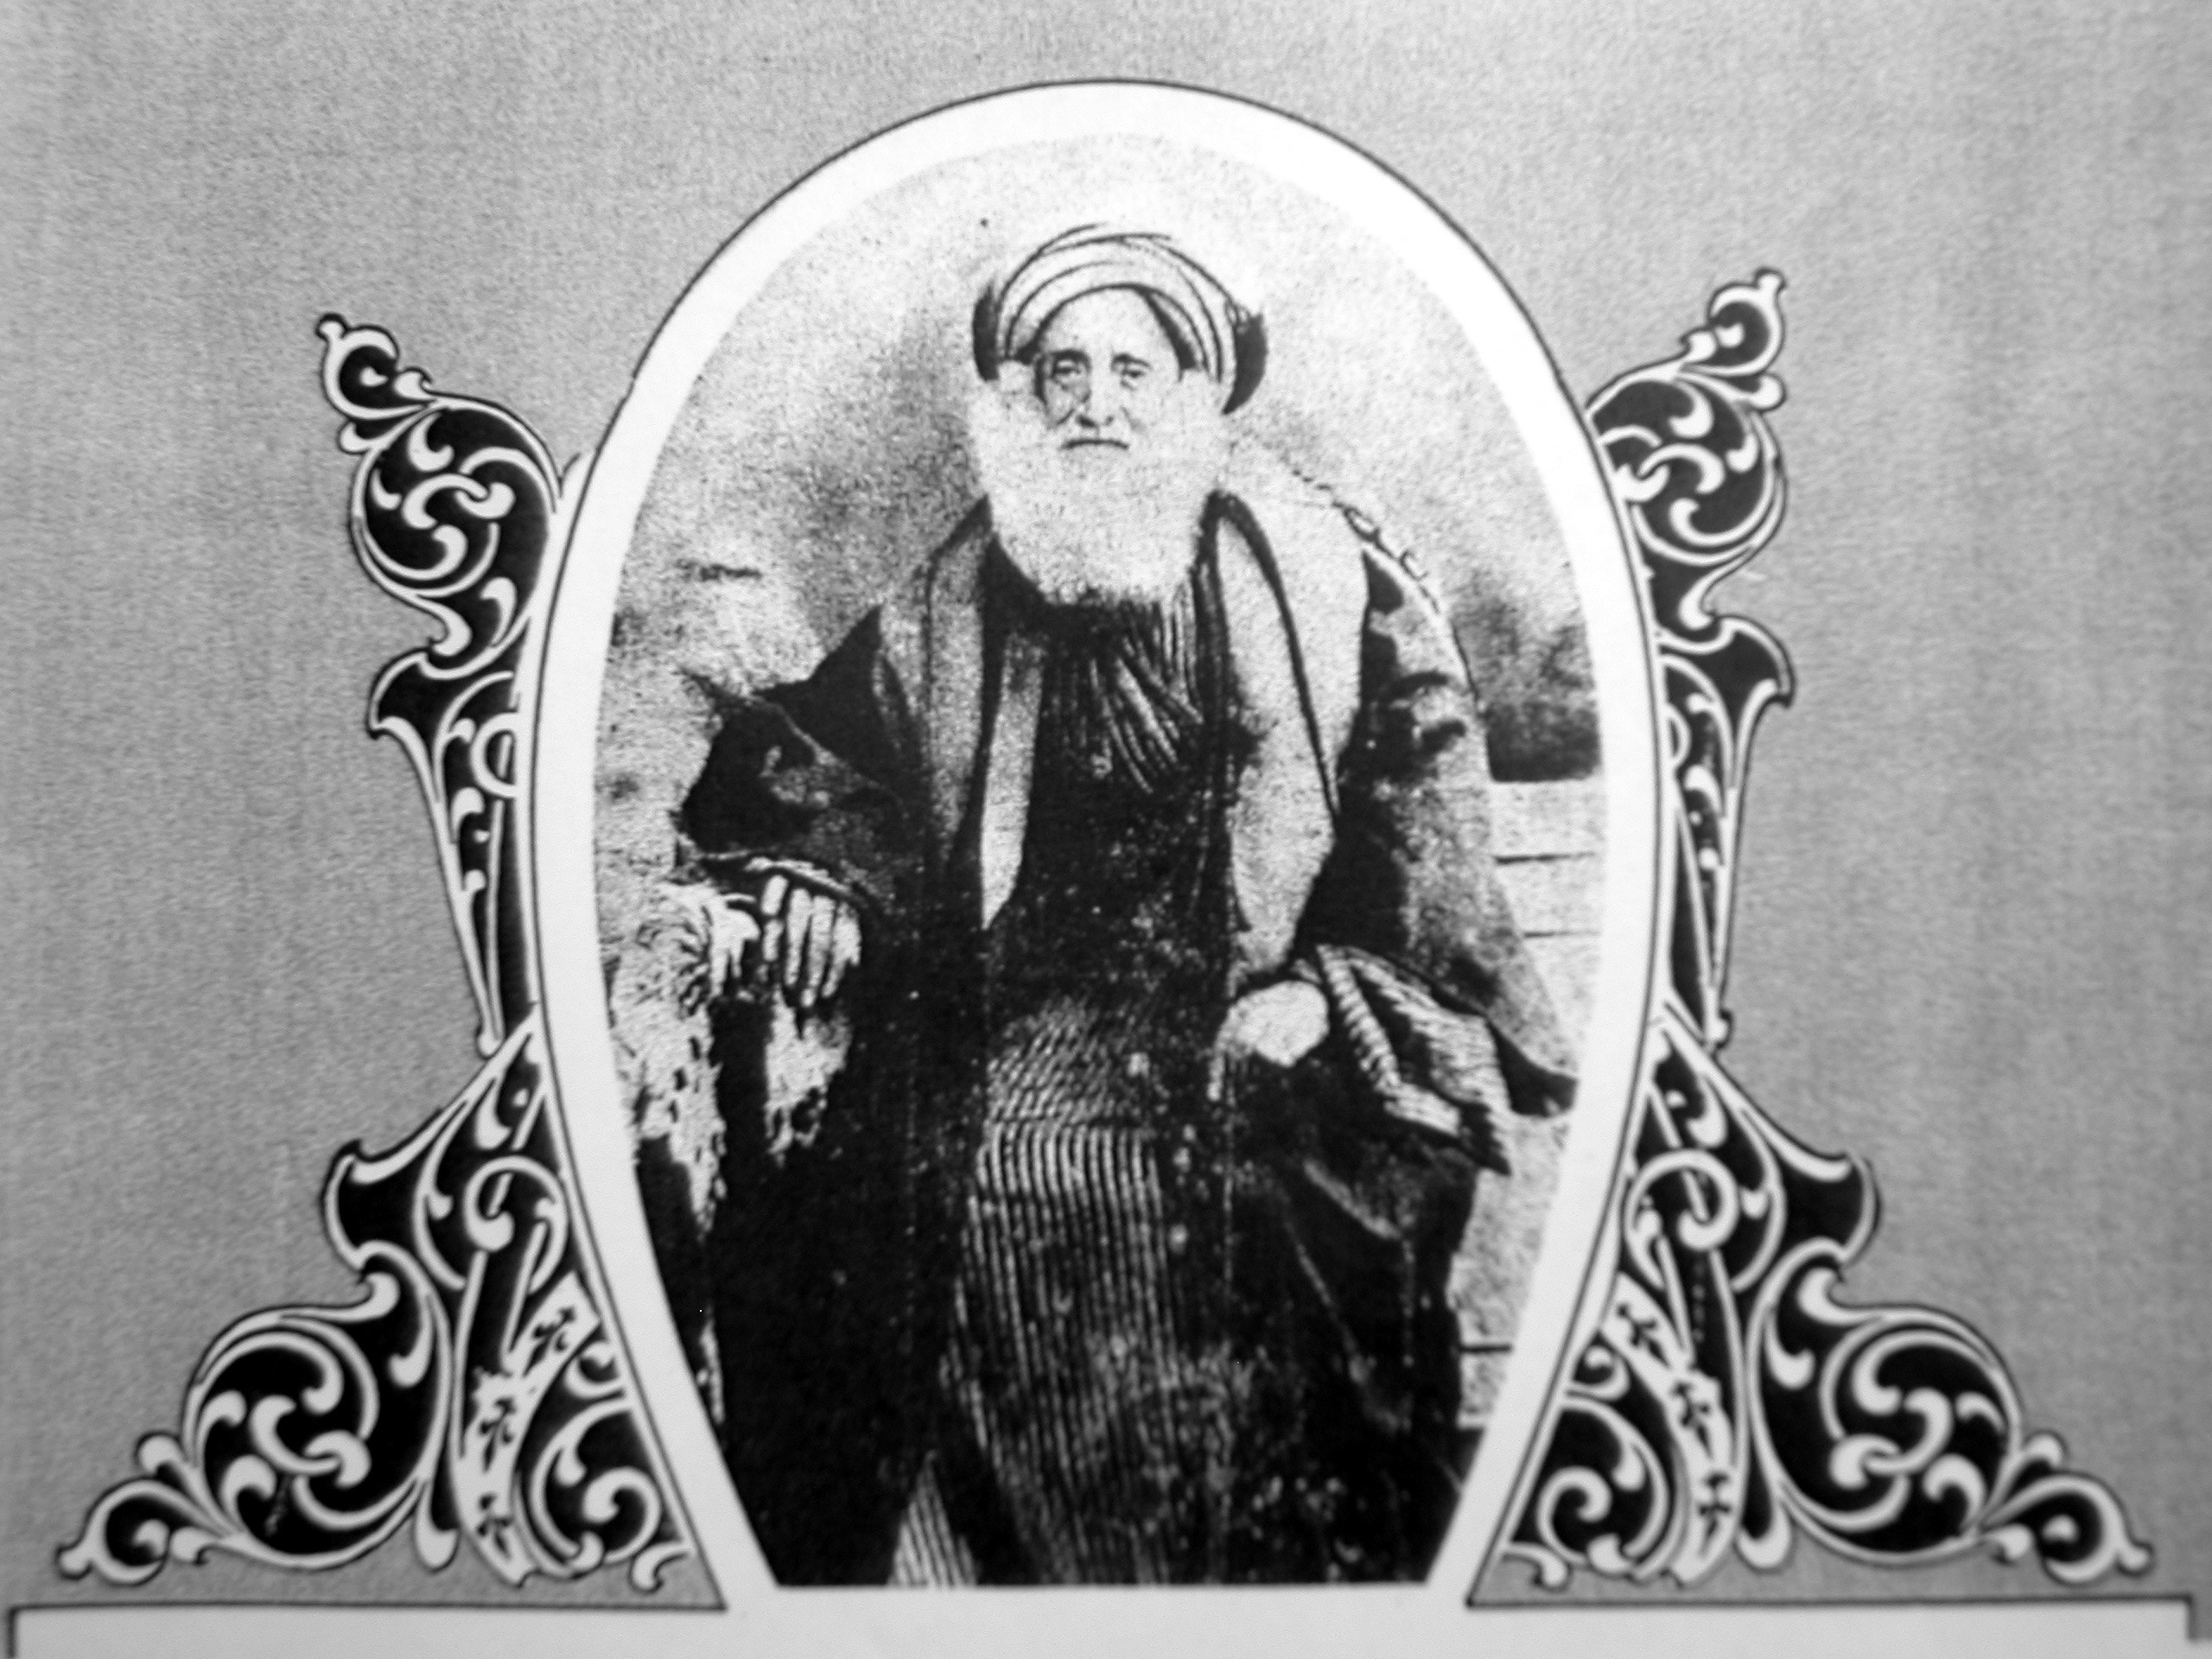

Slide 6
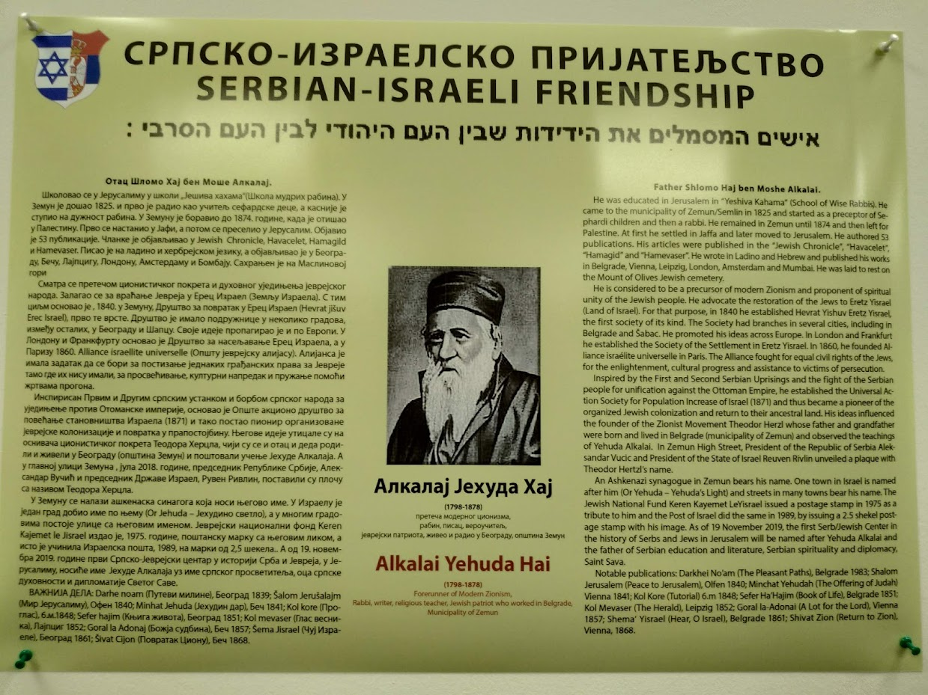

Slide 7
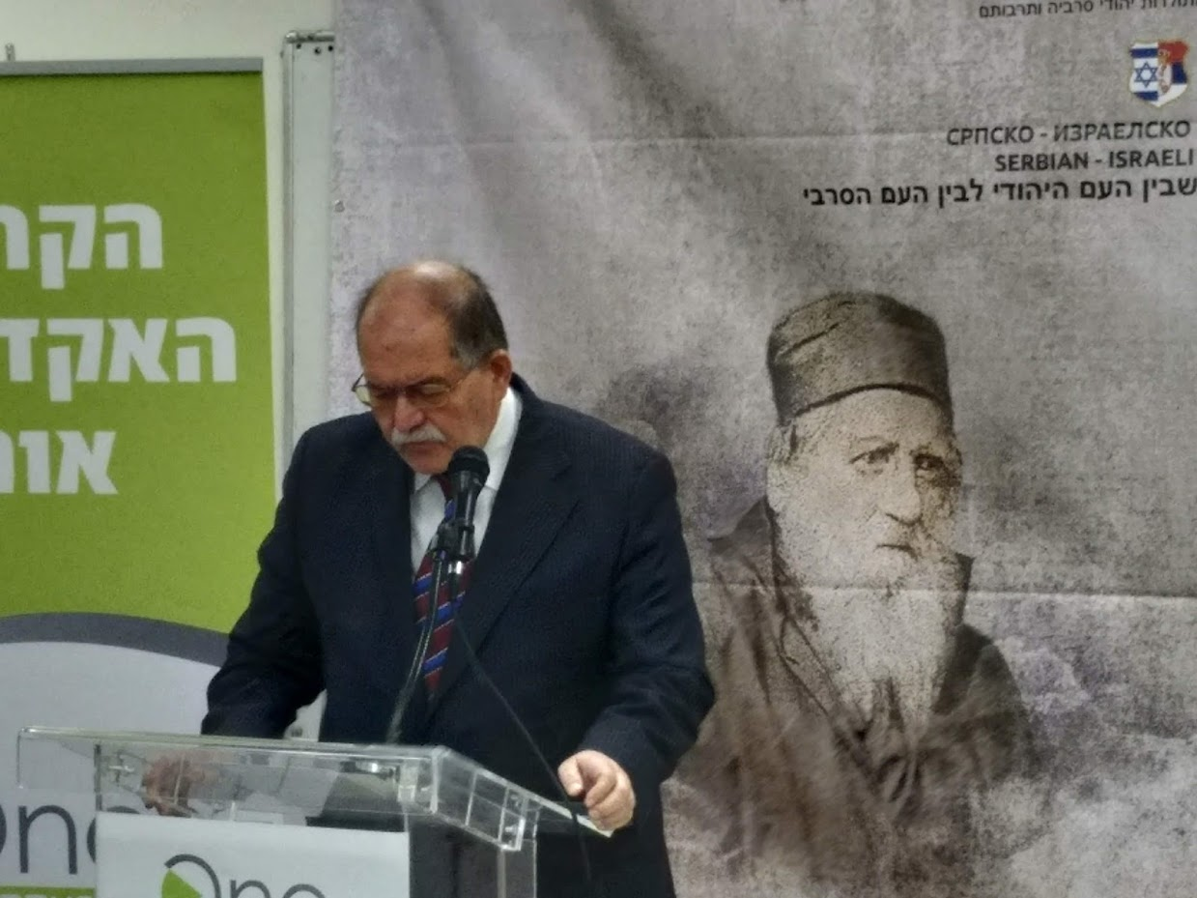

Slide 8
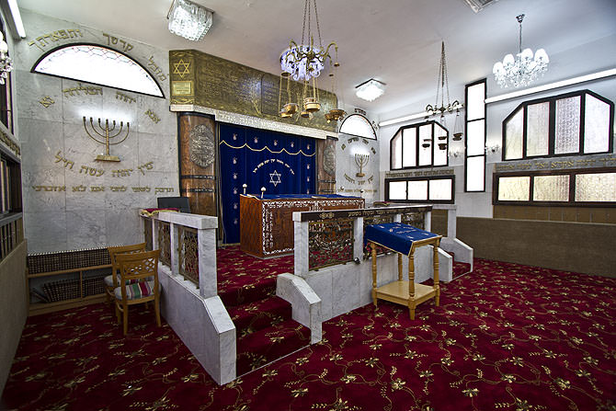

Slide 9
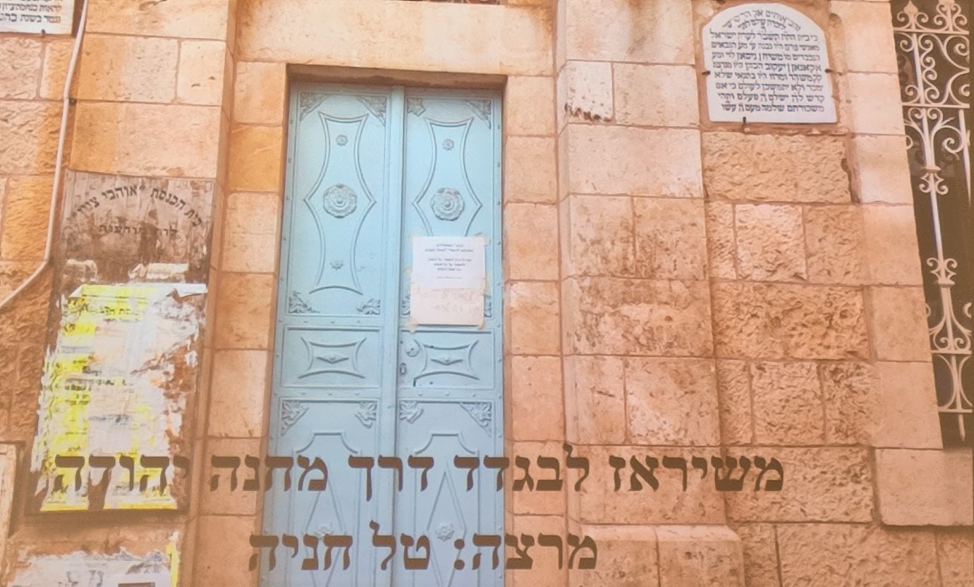

Slide 10
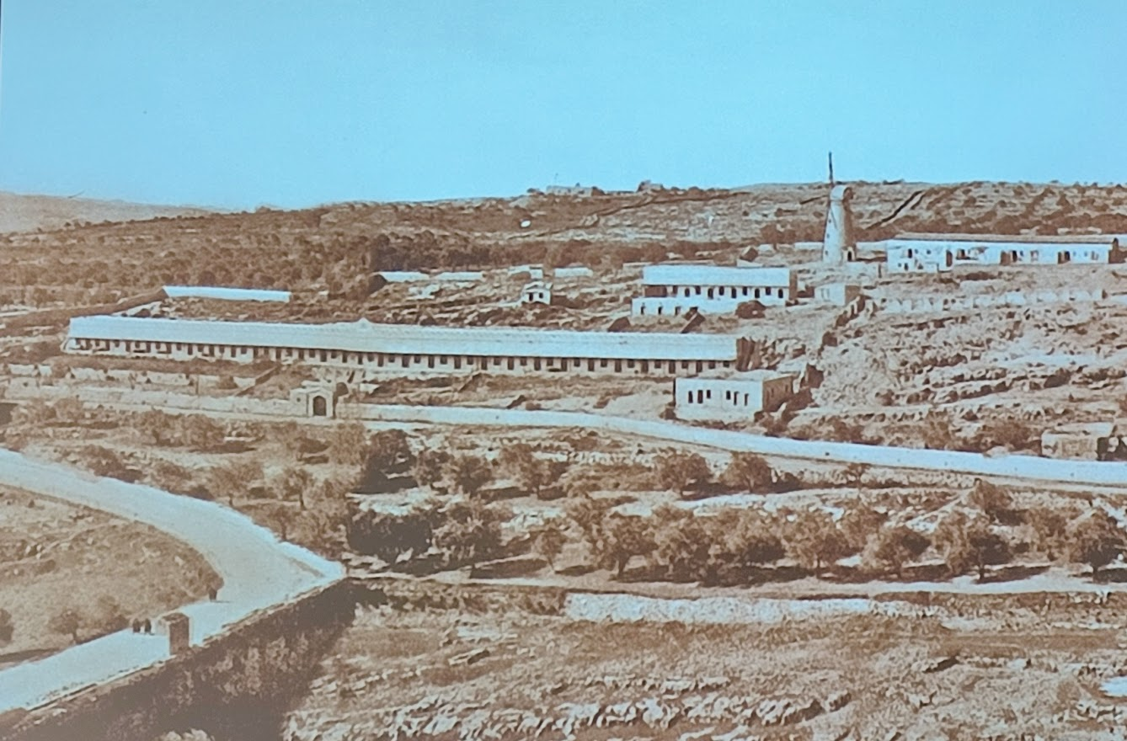

Slide 11
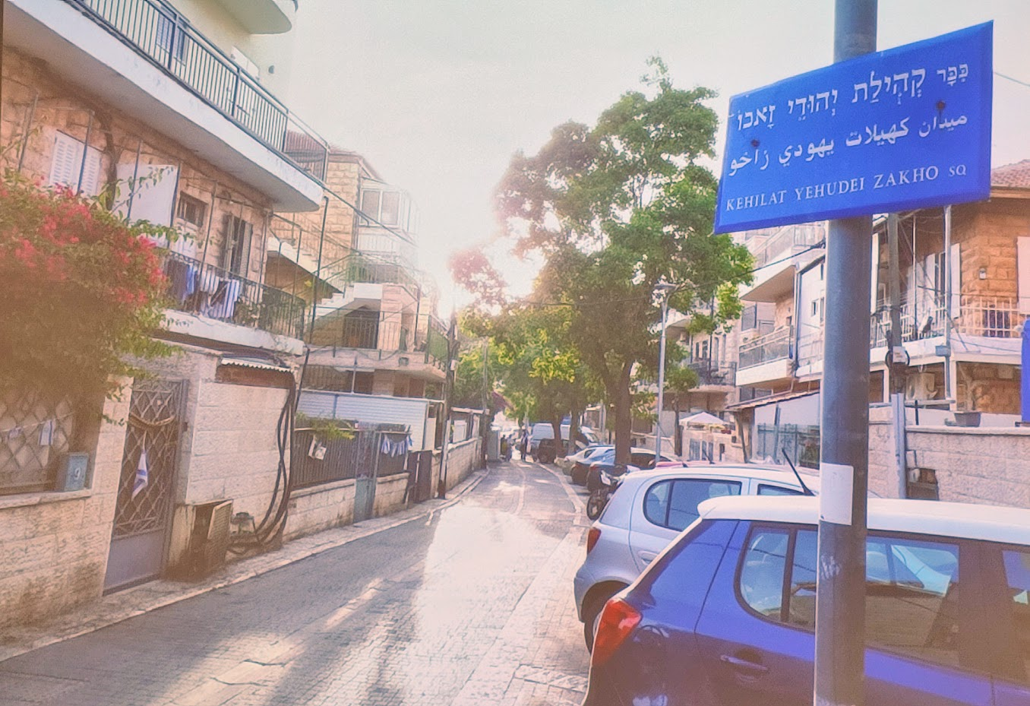

Slide 12
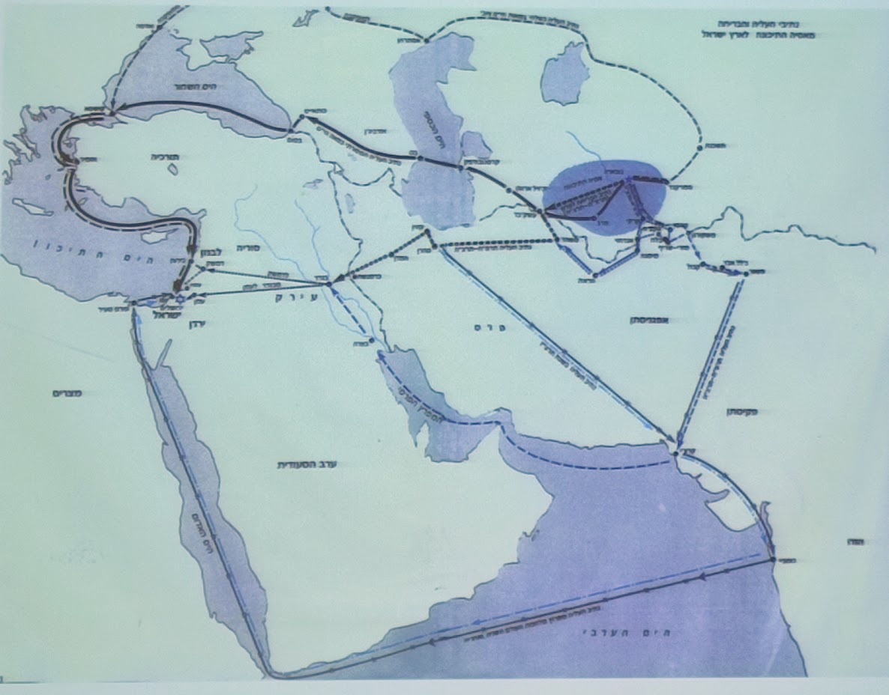

Slide 13
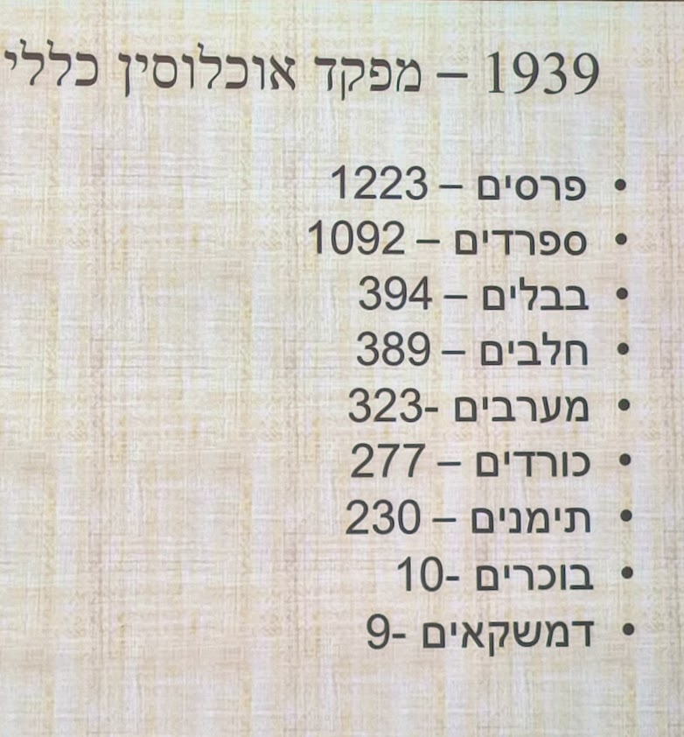

Slide 14
https://www.youtube.com/watch?v=n8-fnQfzMgA&ab_channel=%D0%B3%D1%80%D1%83%D0%B7%D0%B8%D0%BD%D1%8B%D0%BF%D0%BE%D1%8E%D1%82

Slide 15
https://www.youtube.com/watch?v=UFCwVWGqPvo&ab_channel=%D0%A2%D0%B5%D0%BC%D1%83%D1%87%D0%B8%D0%BD

